Slide 1
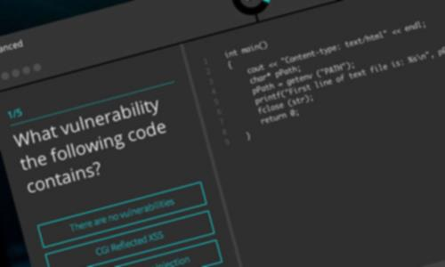
Amit Ashbel
Product Marketing Manager
www.gameofhacks.com

Slide 2
How I am about to spend your time?
What is GoH?
What's behind it?
Not so wet T-Shirt contest
Node.js potential risks
Takeaways

Slide 3
Game of Hacks – An idea is born
using System;
using System.Security.Cryptography;
class Program
{
static void Main()
{
using (RNGCryptoServiceProvider rng = new RNGCryptoServiceProvider())
{
// Buffer storage.
byte[] data = new byte[4];
// Ten iterations.
for (int i = 0; i < 10; i++)
{
// Fill buffer.
rng.GetBytes(data);
// Convert to int 32.
int value = BitConverter.ToInt32(data, 0);
Console.WriteLine(value);
}
// other Random Generation method
Random otherRandomGenerator = new Random();
double otherRandomNumber = otherRandomGenerator.NextDouble();
Spot The
Vulnerability

Slide 4
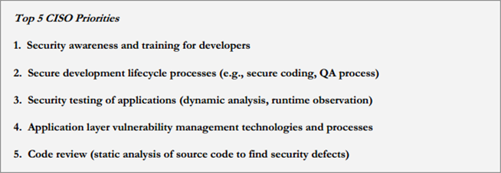
CISO Concerns – Education and Awareness
(https://www.owasp.org/images/2/28/Owasp-ciso-report-2013-1.0.pdf

Slide 5
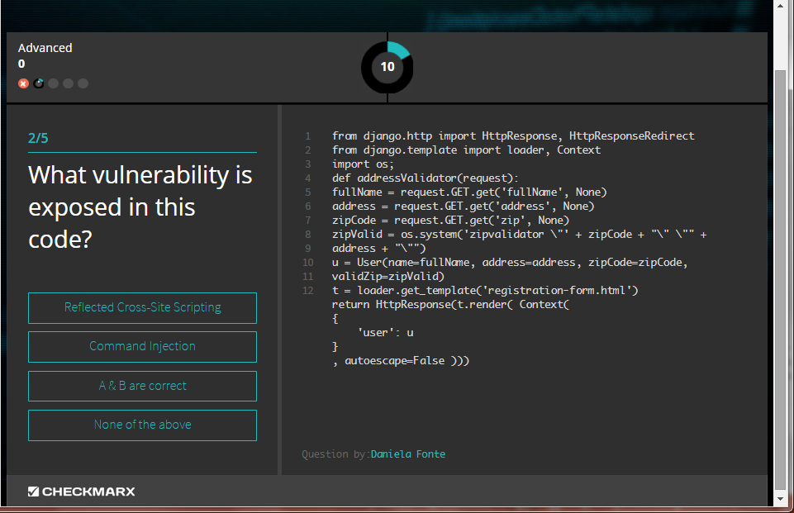
1+1=?
Launched on August
More than 100,000 games were played since

Slide 6
Let’s take a look at the game
Notes:
resolution

Slide 7
What was behind GoH?

Slide 8
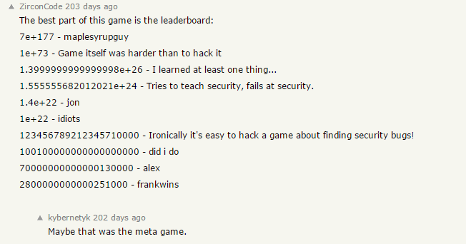
Honeypot
We assumed the game would be attacked
We might as well learn from it
Vulnerabilities were left exposed and patched along the way

Slide 9
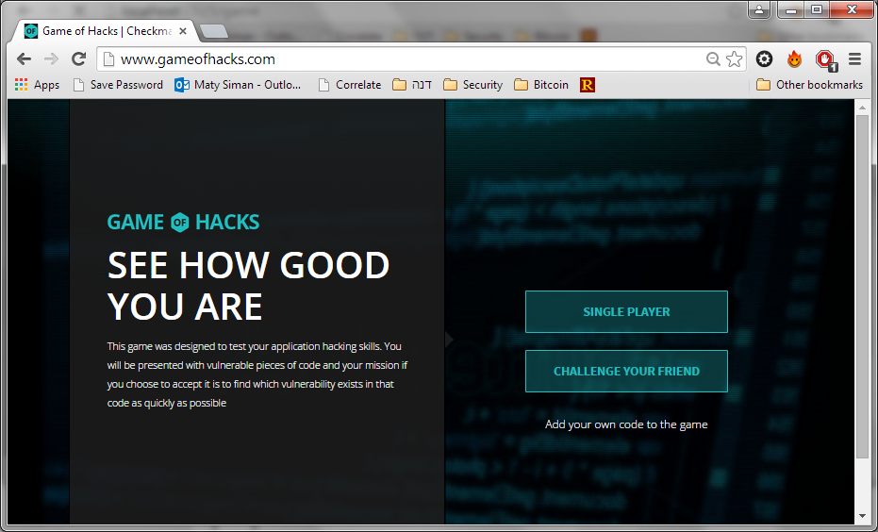
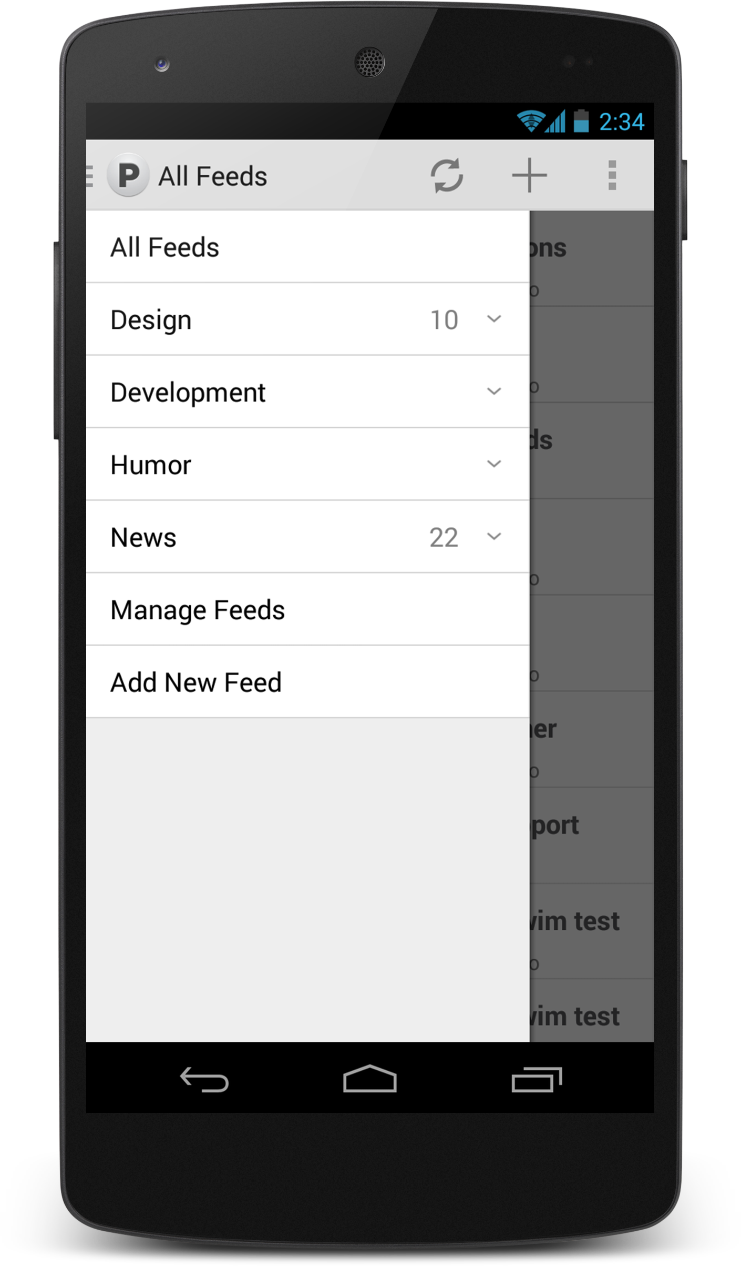
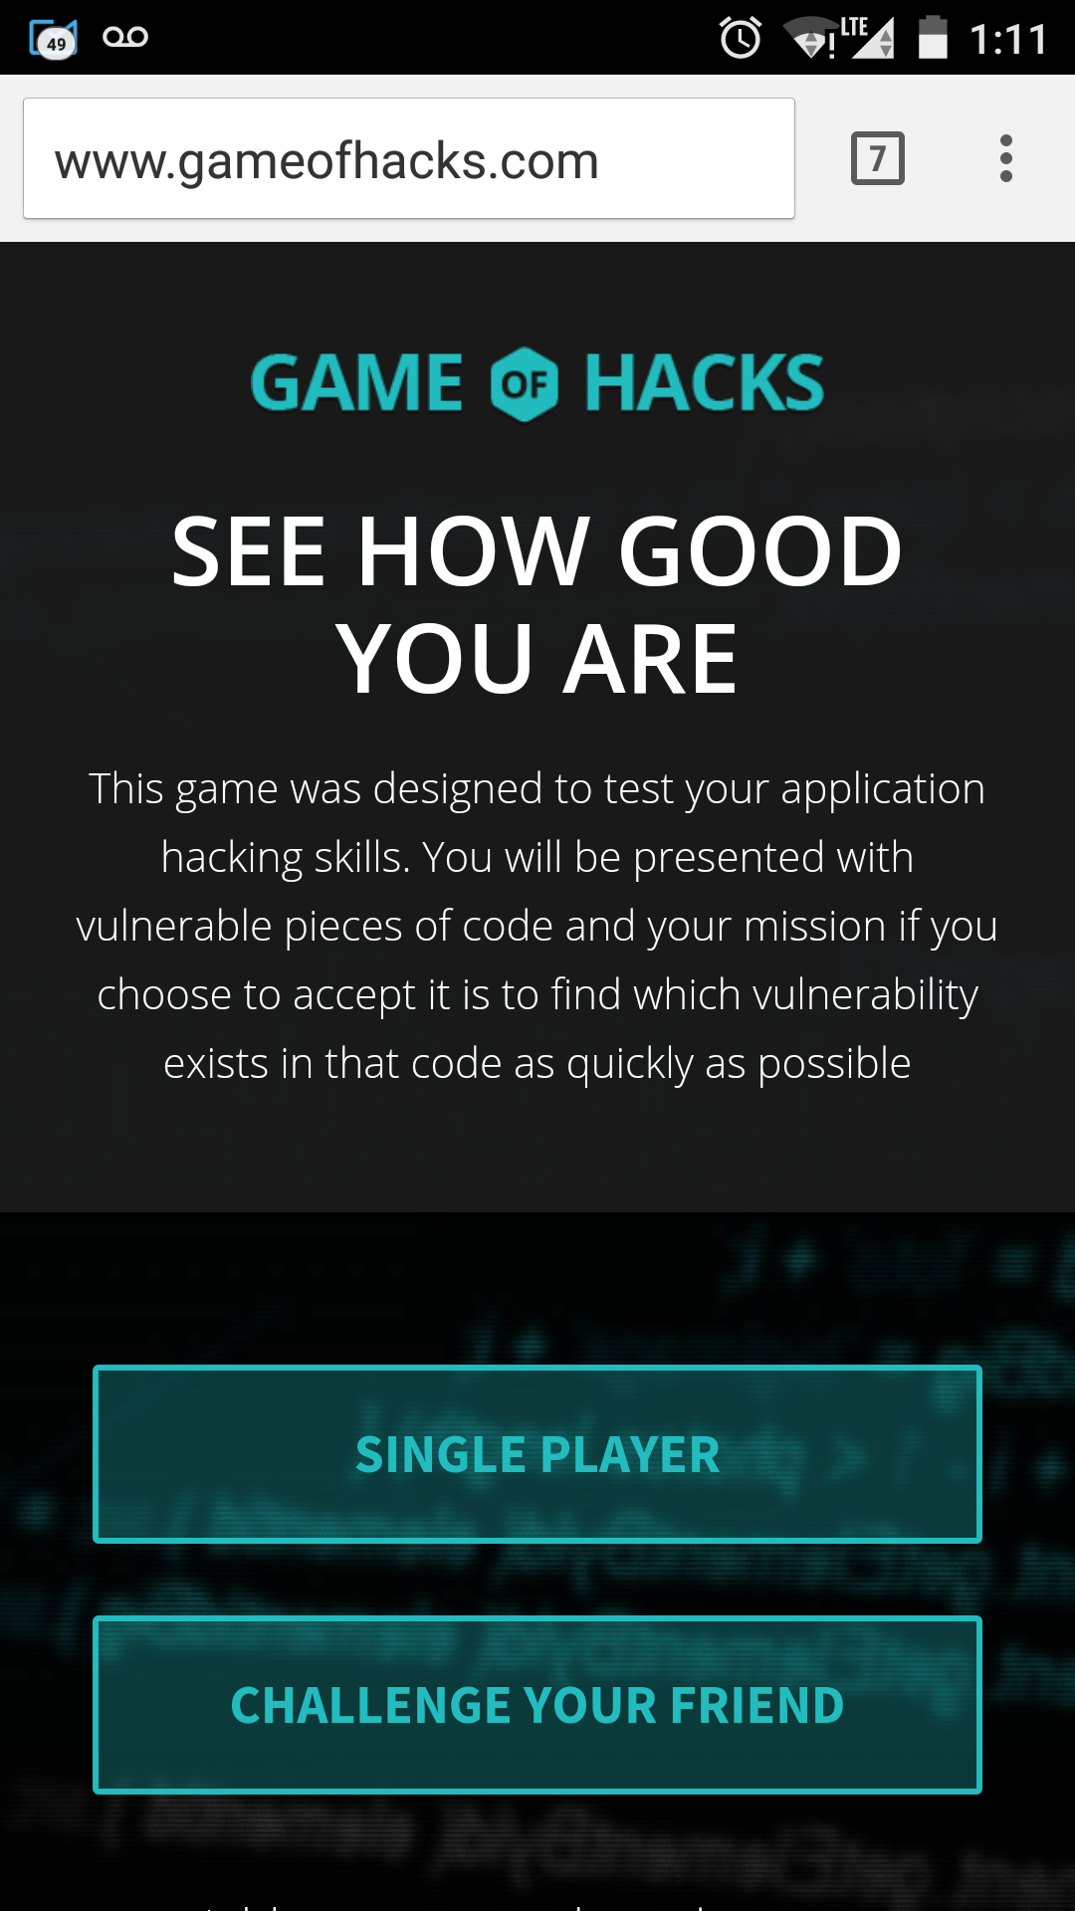
GoH Architecture
Server
Client

Slide 10
Node.js architeture
Single Thread Architecture - Event Loop
Register Callback
Event Queue
File System
Event Loop
Single Thread
Database
Network
Operation Complete Trigger Callback

Slide 11
Event Driven
Single Thread
Events handler

Slide 12
Game Entities
Difficulty Level
60-Second Timer
Score
Question #
Code Snippet
Question
Answers

Slide 13
Answered Question
Initially users initiated app.sendAnswers multiple times, until they got “Correct answer” response.
This allowed malicious users to systematically locate the correct answer – and to gain points over and over for the same question.
Solutions
“Question Already Answered” flag added

Slide 14
Timer
GoH Version 1
Timer handled by client
User forced to go to next question when time ends
Client sends to server Answer + Time spent
So what?
Players stopped timer by modifying JS code
GoH 2
Time is now computed at the server with minor traffic influence

Slide 15
Timer
What else?

Slide 16
Get your Browsers ready!
Checkmarx@Defcon 23
Turn your mobile devices ON!
Go to: www.kahoot.it

Slide 17
More Node.js points to remember

Slide 18
Event Driven - remember?
Single Thread
Events handler

Slide 19
Denial of Service
Function sum (p)
for (i=1;i<=p;++i)
{
f=f+i;
}

Slide 20
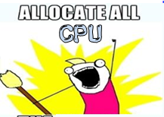
Demo
http://localhost:49090/sum?p=5
http://localhost:49090/sum?p=100000000
http://localhost:49090/sum?p=5

Slide 21
JSON-based SQL Injection
Node.JS, being a JSON based language, can accept JSON values for the .find method:
A user can bypass it by sending
http:///server/page?user[$gt]=a&pass[$gt]=a
http://blog.websecurify.com/2014/08/hacking-nodejs-and-mongodb.html
21

Slide 22
JSON-base SQL Injection
db.users.find({username: username});
This can lead to Regular Expression Denial of Service through the {“username”: {“$regex”: “……..}}
So always validate the input length, structure and permitted characters
Remembering that Node.js is highly sensitive to CPU-intensive tasks, and there’s a single thread for user-code – ReDoS is really bad
bcrypt.compare(candidatePassword, password, cb);

Slide 23
Re-Dos Demo
http://localhost:49090/?user=admin&pass[$regex]=^(a|a|a|a|a|a|a|a|a|a|a|a|a|a|a|a|a|a|a|a|a|a|a|a|a|a|a|a|a|a|a|a|a|a|a|a|a|a|a|a|a|a|a|a|a|a|a|a|a|a|a|a|a|a|a|a|a|a|a|a|a|a|a|a|a|a|a|a|a|a|a|a|a|a|a|a|a|a|a|a|a|a|a|a|a|a|a|a|a|a|a|a|a|a|a|a|a|a|a|a|a|a|a|a|a|a|a|a|a|a|a|a|a|a|a|a|a|a|a|a|a|a|a|a|a|a|a|a|a|a|a|a|a|a|a|a|a|a|a|a|a|a|a|a|a|a|a|a|a|a|a|a|a|a|a|a|a|a|a|a|a|a|a|a|a|a|a|a|a|a|a|a|a|a|a|a|a|a|a|a|a|a|a|a|a|a|a|a|a|a|a|a|a|a|a|a|a|a|a|a|a|a|a|a|a|a|a|a|a|a|a|a|a|a|a|a|a|a|a|a|a|a|a|a|a|a|a|a|a|a|a|a|a|a|a|a|a|a|a|a|a|a|a|a|a|a|a|a|a|a|a|a|a|a|a|a|a|a|a|a|a|a|a|a|a|a|a|a|a|a|a|a|a|a|a|a|a|a|a|a|a|a|a|a|a|a|a|a|a|a|a|a|a|a|a|a|a|a|a|a|a|a|a|a|a|a|a|a|a|a|a|a|a|a|a|a|a|a|a|a|a|a|a|a|a|a|a|a|a|a|a|a|a|a|a|a|a|a|a|a|a|a|a|a|a|a|a|a|a|a|a|a|a|a|a|a|a|a|a|a|a|a|a|a|a|a|a|a|a|a|a|a|a|a|a|a|a|a|a|a|a|a|a|a|a|a|a|a|a|a|a|a|a|a|a|a|a|a|a|a|a|a|a|a|a|a|a|a|a|a|a|a|a|a|a|a|a|a|a|a|a|a|a|a|a|a|a|a|a|a|a|a|a|a|a|a|a|a|a|a|a|a|a|a|a|a|a|a|a|a|a|a|a|a|a|a|a|a|a|a|a|a|a|a|a|a|a|a|a|a|a|a|a|a|a|a|a|a|a|a|a|a|a|a|a|a|a|a|a|a|a|a|a|a|a|a|a|a|a|a|a|a|a|a|a|a|a|a|a|a|a)(d|d|d|d|d|d|d|d|d|d|d|d|d|d|d|d|d|d|d|d|d|d|d|d|d|d|d|d|d|d|d|d|d|d|d|d|d|d|d|d|d|d|d|d|d|d|d|d|d|d|d|d|d|d|d|d|d|d|d|d|d|d|d|d|d|d|d|d|d|d|d|d|d|d|d|d|d|d|d|d|d|d|d|d|d|d|d|d|d|d|d|d|d|d|d|d|d|d|d|d|d|d|d|d|d|d|d|d|d|d|d|d|d|d|d|d|d|d|d|d|d|d|d|d|d|d|d|d|d|d|d|d|d|d|d|d|d|d|d|d|d|d|d|d|d|d|d|d|d|d|d|d|d|d|d|d|d|d|d|d|d|d|d|d|d|d|d|d|d|d|d|d|d|d|d|d|d|d|d|d|d|d|d|d|d|d|d|d|d|d|d|d|d|d|d|d|d|d|d|d|d|d|d|d|d|d|d|d|d|d|d|d|d|d|d|d|d|d|d|d|d|d|d|d|d|d|d|d|d|d|d|d|d|d|d|d|d|d|d|d|d|d|d|d|d|d|d|d|d|d|d|d|d|d|d|d|d|d|d|d|d|d|d|d|d|d|d|d|d|d|d|d|d|d|d|d|d|d|d|d|d|d|d|d|d|d|d|d|d|d|d|d|d|d|d|d|d|d|d|d|d|d|d|d|d|d|d|d|d|d|d|d|d|d|d|d|d|d|d|d|d|d|d|d|d|d|d|d|d|d|d|d|d|d|d|d|d|d|d|d|d|d|d|d|d|d|d|d|d|d|d|d|d|d|d|d|d|d|d|d|d|d|d|d|d|d|d|d|d|d|d|d|d|d|d|d|d|d|d|d|d|d|d|d|d|d|d|d|d|d|d|d|d|d|d|d|d|d|d|d|d|d|d|d|d|d|d|d|d|d|d|d|d|d|d|d|d|d|d|d|d|d|d|d|d|d|d|d|d|d|d|d|d|d|d|d|d|d|d|d|d|d|d|d|d|d|d|d|d|d|d|d|d|d|d|d|d|d|d|d|d|d|d|d|d|d|d|d|d|d|d|d|d|d|d|d|d|d|d|d|d|d|d|d|d|d|d|d|d|d|d|d|d|d|d|d|d|d|d|d|d|d|d|d|d|d|d|d|d|d|d|d|d|d|d|d|d|d|d|d|d|d|d|d|d|d|d|d|d|d|d|d|d|d|d|d|d|d|d|d|d|d|d|d|d|d|d|d|d|d|d|d|d|d|d|d|d|d|d|d|d|d|d|d|d|d|d|d|d|d|d|d|d|d|d|d|d|d|d|d|d|d|d|d|d|d|d|d|d|d|d|d|d|d|d|d|d|d|d|d|d|d|d|d|d|d|d|d|d|d|d|d|d|d|d|d|d|d|d|d|d|d|d|d|d|d|d|d|d|d|d|d|d|d|d|d|d|d|d|d|d|d|d|d|d|d|d|d|d|d|d|d|d|d|d|d|d|d|d|d|d|d|d|d|d|d|d|d|d|d|d|d|d|d|d|d|d|d|d|d|d|d|d|d|d|d|d|d|d|d|d|d|d|d|d|d|d|d|d|d|d|d|d|d|d|d|d|d|d|d|d|d|d|d|d|d|d|d|d|d|d|d|d|d|d|d|d|d|d|d|d|d|d|d|d|d|d|d|d|d|d|d|d|d|d|d|d|d|d|d|d|d|d|d|d|d|d|d|d|d|d|d|d|d|d|d|d|d|d|d|d|d|d|d|d|d)$

Slide 24
Some Key Takeaways
Gamification of education
Knowledge is key to deliver secure code
Students (of all ages) absorb and retain information better
Anytime you have a chance to make learning a fun experience you should do it
Using code
Always validate the input length, structure and permitted characters
Each coding language has its own pitfalls
Research and learn a language before you use it publicly.
Remember - Node.js is highly sensitive to CPU-intensive tasks

Slide 25
Thank You
Questions?
amit.ashbel@checkmarx.com
Amit Ashbel
@aashbel

