Slide 1
Integrating Mobile/BYOD into your Enterprise Security Testing Program
Mobile Security Vulnerability Assessment Tools for the Enterprise
Georgia Weidman

Slide 2
Is this a mobile device?

Slide 3
Toilet Mobile Vulnerability
Trustwave SpiderLabs Security Advisory TWSL2013-020:
Hard-Coded Bluetooth PIN Vulnerability in LIXIL Satis Toilet
Controlled via an Android app with a hardcoded pin “0000”
“Attackers could cause the unit to unexpectedly open/close the lid, activate bidet or air-dry functions, causing discomfort or distress to user.”

Slide 4
Is this a mobile device?

Slide 5
Car Hacked through Mobile Modem

Slide 6
Is this a mobile device?

Slide 7
Mobile Risks

Slide 8
Mobile Risks

Slide 9
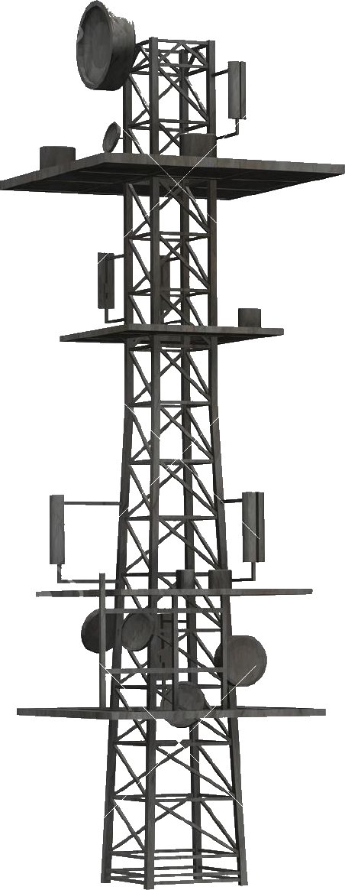
Mobile Remote Attacks
Malicious Carrier Update
Remote Code Execution Bugs
Vulnerable Listening Services

Slide 10
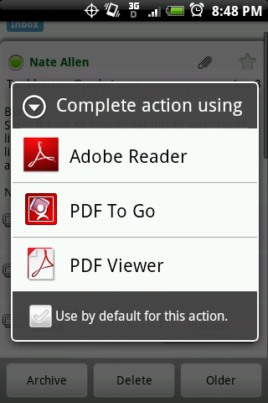
Mobile Client Side Attacks
Browser and Web Extensions
Mobile Apps
Mobile Protocols

Slide 11
Mobile Phishing Attacks

Slide 12
Malicious Applications
Repackage apps with malicious code
Appears normal to the user, malicious functionality in the background
Sign apps with stolen developer keys (avoids iOS restrictions), signing vulnerability (Android master key), or attacker created keys.
Stealthy malware can be uploaded into official stores and company app stores

Slide 13
Mobile Post Exploitation
Steal Data (emails, passwords, text messages, location information)
Control device (send messages, post on Twitter, record video of user)
Privilege Escalation (break out of sandboxes, get access to additional information/control)
Mobile Pivoting (attacking other devices on the network, bypassing perimeter controls)

Slide 14
Mobile Pivoting

Slide 15
Mobile Pivoting

Slide 16
Mobile Security Controls
Enterprise Mobility Management/Mobile Device Management
Mobile Antivirus
Data Containers
Hardened Platforms
Data Loss Prevention at Perimeter

Slide 17
Mobile Security Testing
Getting sensitive data out of a sandbox/container
Known malware running on device undetected
Root/jailbreak undetected
Downloading and running applications outside of policy
Bypass perimeter controls with mobile pivoting

Slide 18
DEMOS!

Slide 19
Questions to Ask Operations
Is my Mobile Device Management (MDM) solution set up correctly and providing value? Does it actually do what it says on the box it will do?
Are my users responding correctly to mobile based phishing attacks? Do my users install apps from 3rd party app stores?
Is my mobile anti-virus solution warning users before they install something potentially malicious? Does it at least match known threat samples?
What would a compromised mobile device be able to access over the network? What sort of sensitive data is stored or transmitted through mobile devices?
Would a compromised mobile device in my network be able to compromise and exfiltrate data?

Slide 20
Contact
Georgia Weidman
Bulb Security LLC/Shevirah Inc.
georgia@bulbsecurity.com
www.bulbsecurity.com
@georgiaweidman

