Slide 1
A new hope CTF Stories & IOT HACKING
Alex Balan – Chief Security Researcher
abalan@bitdefender.com | @jaymzu
Catalin Cosoi – Chief Security Strategist
ccosoi@bitdefender.com

Slide 2
About.us
Bitdefender protects over 500M users worldwide
The two of us are part of a team that “hacks the hackers” and brings down bad guys
The same team has a fetish for participating in CTFs and training the younger generation
We have a strong focus on IoT

Slide 4
Cisco projected 50 billion connected devices by 2020…
Source: An S&R Pro’s Guide To IoT Security How The Internet Of Things Will Shatter Traditional Enterprise Security by Tyler Shields, Michele Pelino, and Andras Cser August 14, 2015

Slide 5
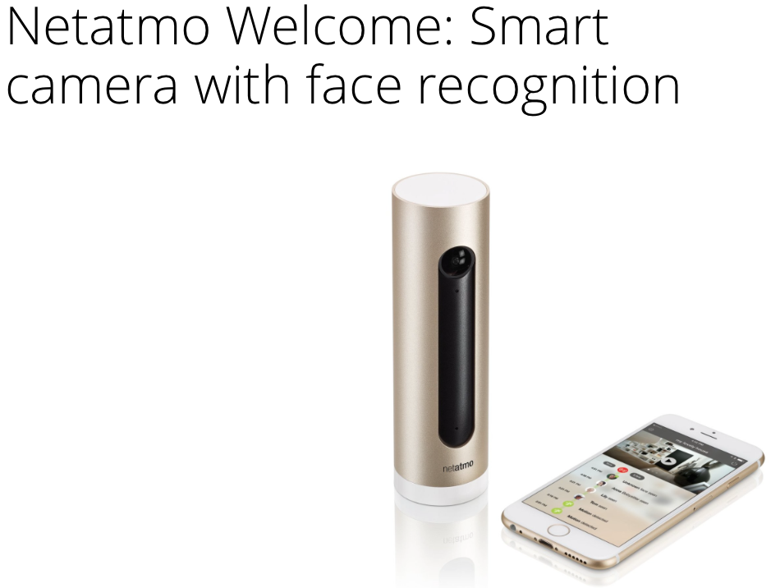
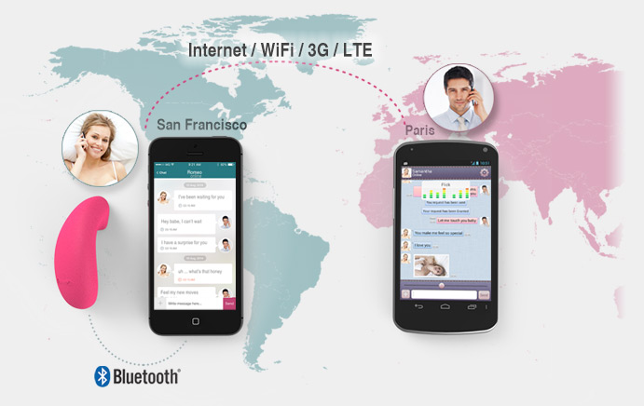
Cisco projected 50 billion connected devices by 2020…
Source: An S&R Pro’s Guide To IoT Security How The Internet Of Things Will Shatter Traditional Enterprise Security by Tyler Shields, Michele Pelino, and Andras Cser August 14, 2015

Slide 6
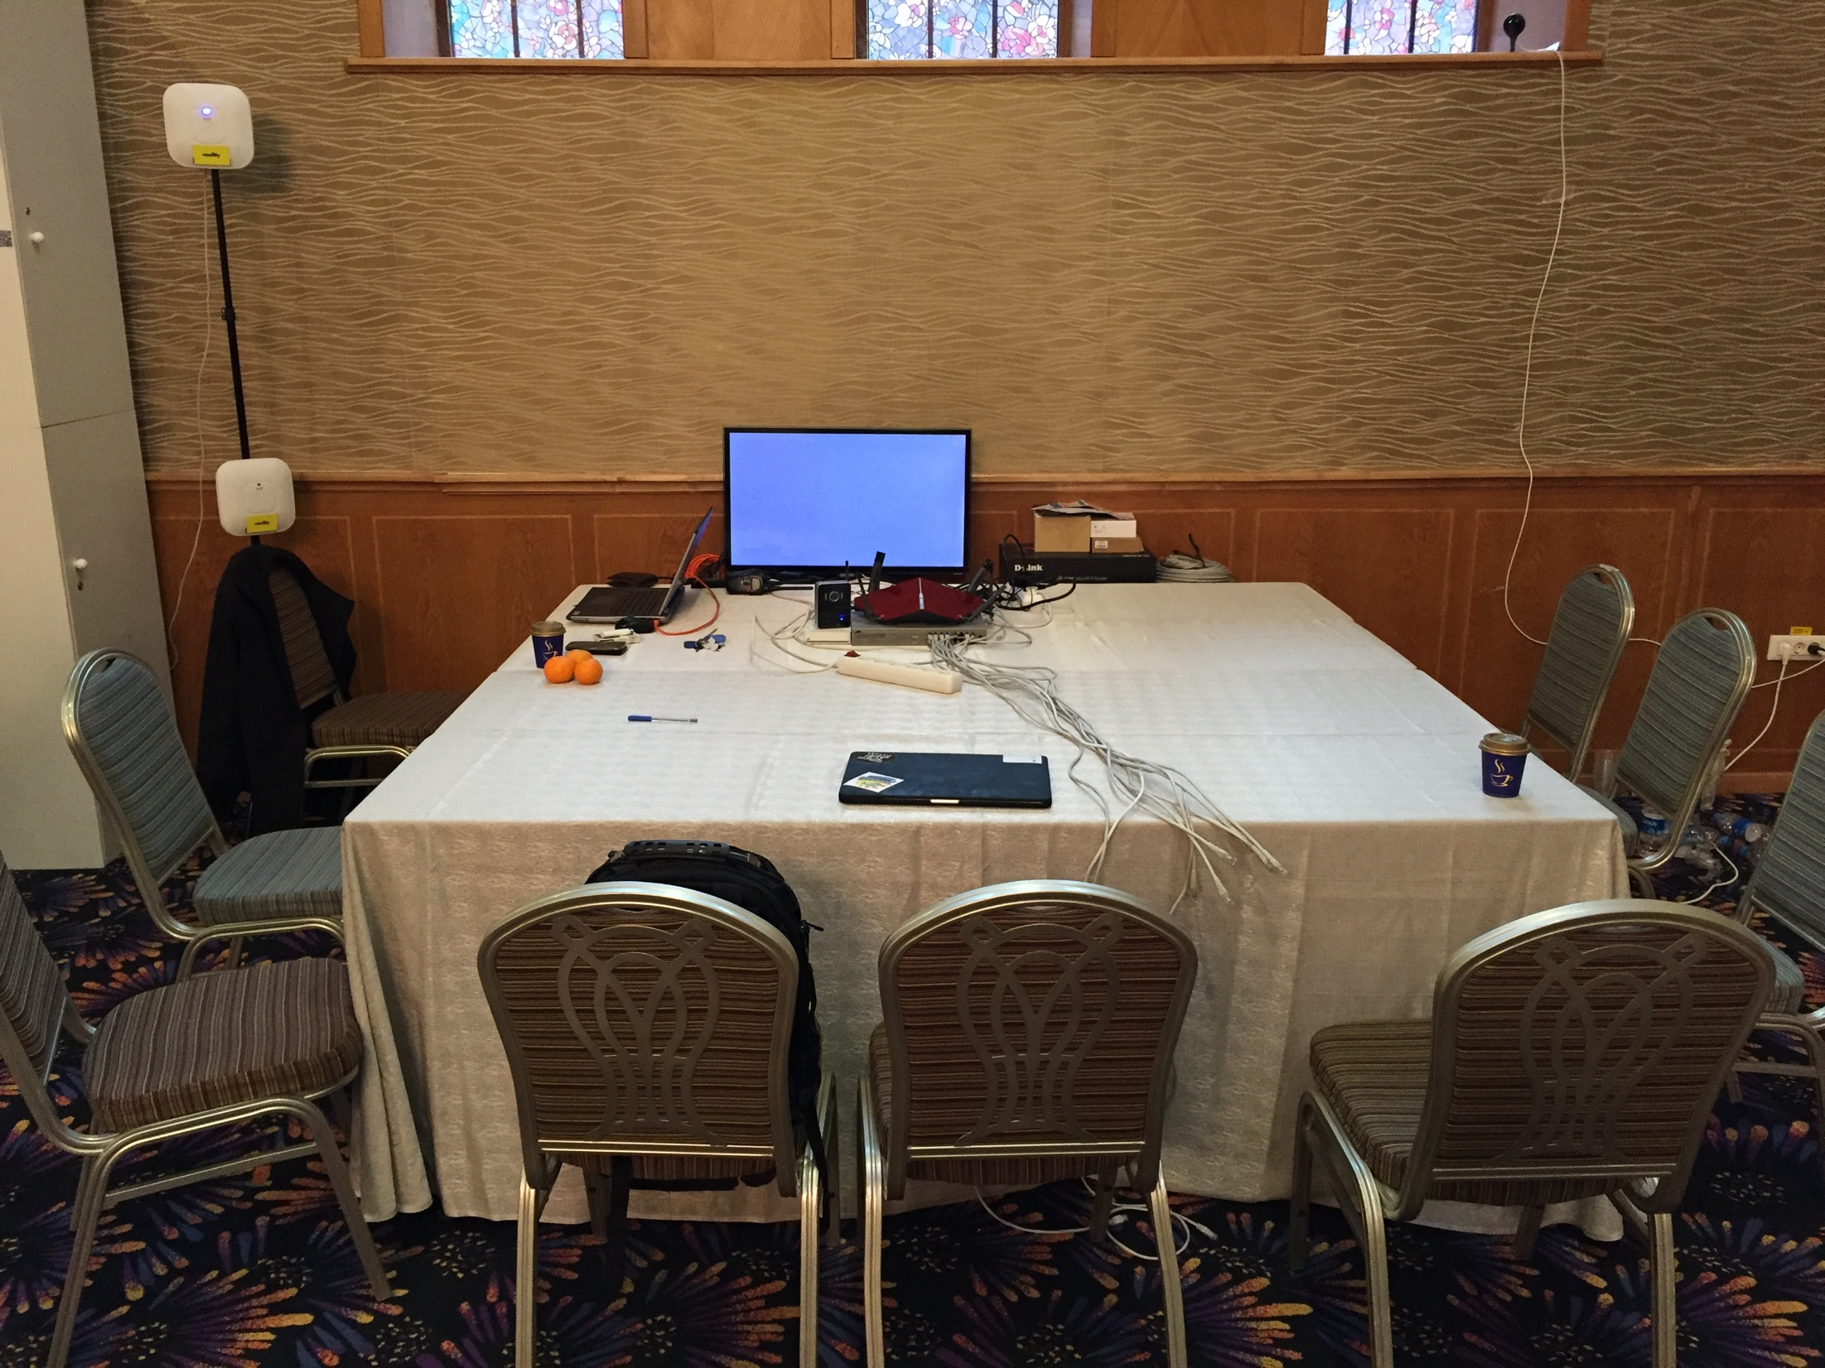
Iot village

Slide 7
Questions ?

