Slide 1
Building a Cyber Security Operations Center (CSOC)
Shah H Sheikh – Co-Founder & Sr. Security Solutions Consultant
MEng CISSP CISA CISM CRISC CCSK CCSA
DTS Solution - UAE
shah@dts-solution.com

Slide 2
Cyber Security Operations Center
Agenda – Building a Cyber Security Operations Center
1. The need to build an enterprise-wide CSOC.
2. CSOC 2.0 and its components to form an eco-system.
3. SIEM 2.0 – Log Collection, Log Aggregation, Security Analytics and Correlation.
4. Specific Contextual Threat and Use Cases and Situational Awareness
5. Building Threat Intelligence and Early Warning Detection System
6. CSOC Processes, Procedures and Workflows.
7. CSOC Incident Response Handling
8. Cyber Incident Offense Management
9. CSOC vs. Security Maturity Levels
People, Process and Technology

Slide 3
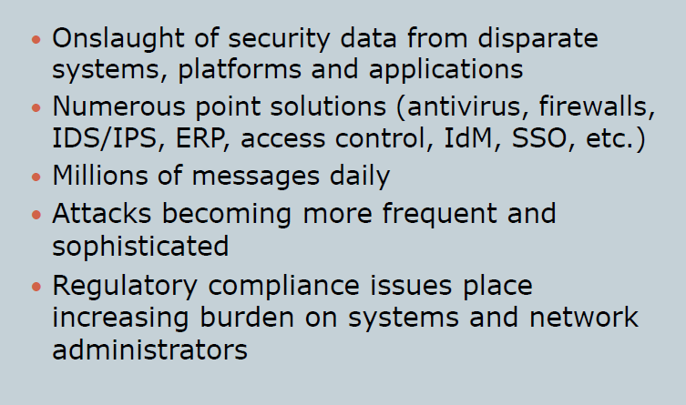
Current Challenges

Slide 4
Current Challenges

Slide 5
The current CSOC landscape…

Slide 6
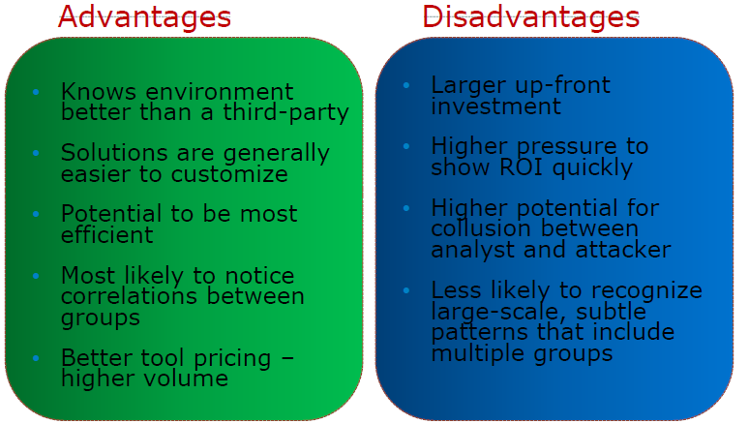
Outsourced or In-house ?!?
… VS …
In-Housed SOC

Slide 7
Why build a CSOC?

Slide 8
Key Objectives for CSOC … (1)
Manages and Coordinates the response to Cyber Threats and Incidents
Monitors the Cyber Security posture and reports deficiencies
Coordinates with regulatory bodies
Performs Threat and Vulnerability Analysis
Performs Analysis of Cyber Security Events
Maintains an Internal Database of Cyber Security Incidents
Provide Alerts and Notifications to General and Specific Threats
Provide regular reporting to Management and Cyber Incident Responders

Slide 9
Key Objectives for CSOC … (2)
Reduce the response time of security incident from initial findings, to reporting to containment
Recovery Time Objective (RTO) in case of security incident materializing
Proactive Security Monitoring based on predefined security metrics / KPI
Raise Awareness of Information Security across community of leaders and sub-ordinates
Ability to correlate system, application, network, server, security logs in a consistent way

Slide 10
Key Objectives for CSOC … (3)
Ability to automate the requirement to meet compliance – vulnerability assessment and risk management
Ensure change control function is integrated into the SOC process
Identification for all security attack vectors and classification of incidents
Define disaster recovery plans for ICE (in-case of emergency).
Build a comprehensive reporting dashboard that is aligned to security metrics
Build a local in-house SIRT (security incident response team) that collaborates with National CERT

Slide 11
Key Objectives for CSOC … (4)
To build SOC processes that are aligned to existing ISO27001 security policies
Build a physical and virtual team of SOC personnel for 24 x 7 monitoring
Build forensics capabilities to be able to reconstruct series of events during an incident
Proactive monitoring of network and security infrastructure devices

Slide 12
Components of a CSOC
To build the SOC with simple acceptance and execution model
Maximize the use of technology.
To build security intelligence and visibility that was previously unknown; build effective coordination and response unit and to introduce automation of security process.
Develop SOC processes that are inline to industry best practices and accepted standards – ISO27001:2013, PCI-DSS3.0, IEC-62443, NIST

Slide 13
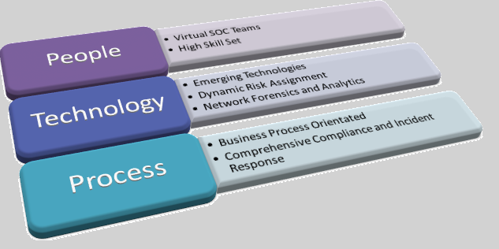
Key Success Factors in a CSOC
The Goal – Keep Things Simple ☺

Slide 14
CSOC – Core Components
Core Components for a CSOC 2.0
OSS – Operational Support System
SIEM – Security Information and Event Management
Proactive Monitoring - Network and Security and Server Infrastructure
Alert and Notification – Security Incident Reporting
Events Correlation and Heuristics / Behavioural / Anomaly

Slide 15
CSOC – Core Components
Core Components for a SOC 2.0
Information and Network Security $$ Automation $$
To natively build-in compliance and audit functions
To manage change control process through integrated ITILv3 CM and SD
Configuration Management of Infrastructure Components

Slide 16
CSOC – Core Components
Core Components for a CSOC 2.0
Alignment of Risk Management with Business Needs
Qualified Risk Ranking
Risks are ranked based on business impact analysis (BIA)
Risk framework is built into the SIEM solution;
incident = risk severity = appropriate remediation and isolation action
SOC is integrated with Vulnerability and Patch Management

Slide 17
CSOC – Core Components
Core Components for a CSOC 2.0
IRH – Incident Response Handling
How effective the SOC is measured by how incidents are managed, handled, administered, remediated and isolated.
Continuous cyclic feedback mechanism drives IRH
Critical functions include Network Forensics and Surveillance Tech..
Reconstruct the incident …. Evidence gathering … Effective Investigation
Escalation Management – know who to communicate during an incident

Slide 18
CSOC – Core Components
Proposed Architecture for the CSOC

Slide 19
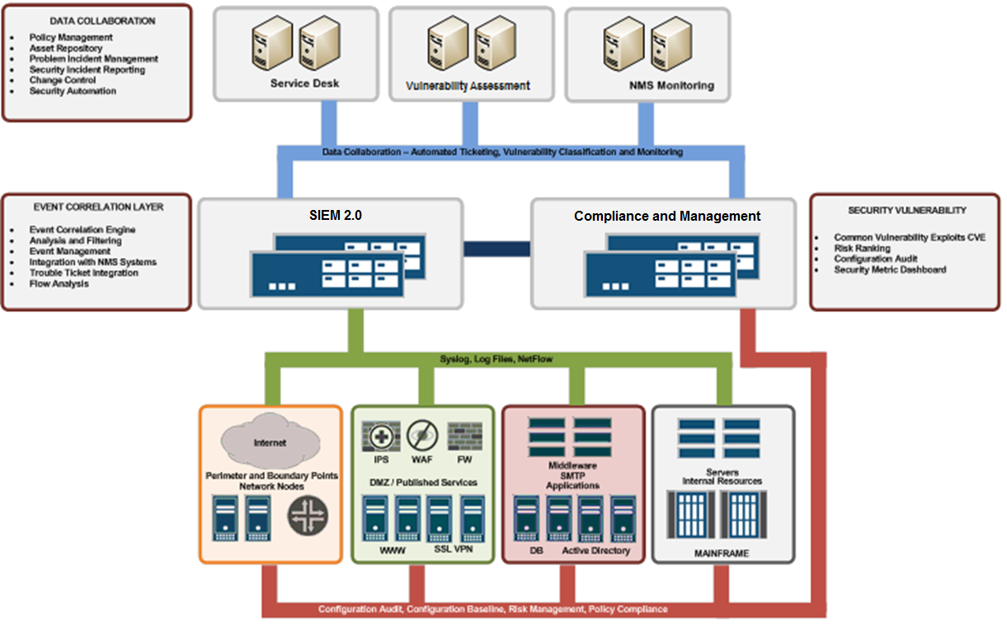
CSOC – Core Components
Integration of Core SOC Components

Slide 20
CSOC Technologies …
SIEM 2.0 Solutions (NOT just Log Management)
Event Collector and Processor – Syslog, Log Files, SMB, ODBC > All Log Sources
Flow Collection and Processor – NetFlow, J-Flow, S-Flow, IPIX
Asset Database (Based on Asset Criticality, Risk and Vulnerability, System and Business Owner)
Event and Flow Correlation – Advanced Threat Analytics
Centralized Management Console for Security Dashboard and Reporting
Integration with service desk for automated ticket creation > Offense Management
Compliance Management and Policy Conformance
Configuration Audit across Infrastructure Systems and Devices
ISO27001 / PCI-DSS3.0 / IEC-62443 Security Policy Compliance
Risk Management – Identification and Mitigation
Baseline Configuration Violation Monitoring (Continuous Compliance / Monitoring)
Network Topology Mapping and Visualization
Vulnerability Assessment and Management

Slide 21
CSOC Technologies …
Network and Security Monitoring (Traditionally owned by the Networking Team) > Integrate with Security Requirements
Network Performance Monitor - SNMP
Network Monitoring
Link Utilization
Availability Monitoring
SLA reporting
Integration with service desk for automated ticket creation
Security Analysis and Threat Intelligence
Network Forensics (Raw Packet Capture > Session Reconstruction)
Situation Awareness
Artifacts and Packet Reconstruction (Chain of Custody)
Monitor all Internet Activity (Linked to Identity (username) as opposed to IPs)
Record metadata for recursive analysis during incident response
Integration with Incident Response Handling (IRH)
Threat Intelligence and Global Landscape

Slide 22
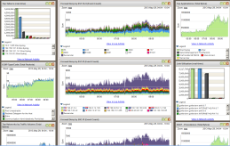
CSOC (before) ….. < The Silos >…
Technology Integration … the old practice
SIEM
Vulnerability Assessment
Network Monitoring

Slide 23
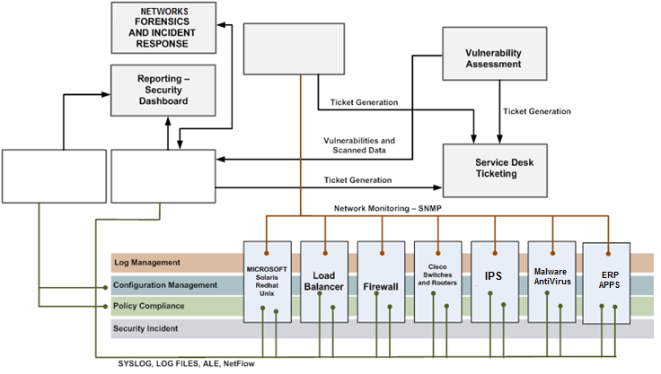
CSOC (after) …. Automation
Technology Integration … the new … WORKFLOW
NMS
Compliance and Monitoring
SIEM 2.0

Slide 24
CSOC – Developing Processes
Creating the CSOC Processes
CSOC Processes, Procedures and Workflows developed should be aligned to Corporate ISMS (if it exists)
DATA SECURITY AND MONITORING
Data Asset Classification
Data Collection
Data Normalization
Data at Rest and In Motion
Data Protection
Data Distribution

Slide 25
CSOC – Developing Processes
Creating the CSOC Processes
CSOC Processes, Procedures and Workflows developed should be aligned to Corporate ISMS (if it exists)
EVENT MANAGEMENT
Event Correlation
Identification
Triage
Roles
Containment
Notification
Ticketing
Recovery
Forensics and Situational Awareness

Slide 26
CSOC – Developing Processes
Creating the CSOC Processes
CSOC Processes, Procedures and Workflows developed should be aligned to Corporate ISMS (if it exists)
INCIDENT RESPONSE PRACTICE
Security Incident Reporting Structure
Security Incident Monitoring
Security Incident Escalation Procedure
Forensics and Root Cause Analysis
Return to Normal Operations
Post-Incident Planning and Monitoring
Communication Guidelines
National CERT Integration

Slide 27
CSOC – Developing Processes
Creating the CSOC Processes
CSOC Processes, Procedures and Workflows developed should be aligned to Corporate ISMS (if it exists)
SOC OPERATING GUIDELINES
SOC Workflow
Personnel Shift Description
Shift Reporting
Shift Change
Information Acquisition
SOC Monitoring Suite
SOC Reporting Structure
Organizational Chart

Slide 28
CSOC – Developing Processes
Creating the CSOC Processes
CSOC Processes, Procedures and Workflows developed should be aligned to Corporate ISMS (if it exists)
ESCALATION MANAGEMENT
Escalation Procedure
Pre-Escalation Tasks
IT Security
Network Operation Center
Security Engineering
National CERT Integration
Law Enforcement
3rd Party Service Providers and Vendors

Slide 29
CSOC – Developing Processes
Creating the CSOC Processes
CSOC Processes, Procedures and Workflows developed should be aligned to Corporate ISMS (if it exists)
DATA RECOVERY PROCEDURES
Disaster Recovery and BCP Procedure
Recovery Time Objective
Recovery Point Objective
Resiliency and High Availability
Facilities Outage Procedure

Slide 30
CSOC – Developing Processes
SECURITY INCIDENT PROCEDURES
Email Phishing - Email Security Incident
Virus and Worm Infection
Anti-Virus Management Incident
NetFlow Abnormal Behavior Incident
Network Behaviour Analysis Incident
Distributed Denial of Service Incident
Host Compromise - Web Application Security Incident
Network Compromise
Internet Misuse
Human Resource - Hiring and Termination
Domain Hijack or DNS Cache Poisoning
Suspicious User Activity
Unauthorized User Access (Employee)

Slide 31
CSOC – Developing Processes
Creating the CSOC Processes
CSOC Processes, Procedures and Workflows developed should be aligned to Corporate ISMS (if it exists)
VULNERABILITY AND PATCH MANAGEMENT
Vulnerability Research (Threat Intelligence)
Notifications sent to respective system owners
Patch Management - Microsoft SCOM
Identification
Dissemination
Compliance Monitoring
Network Configuration Baseline
Anti-Virus Signature Management
Microsoft Updates

Slide 32
CSOC – Developing Processes
Creating the CSOC Operating Manuals
TOOLS OPERATING MANUAL FOR CSOC PERSONNEL
Operating Procedure for SIEM 2.0 Solution – Event Management and Flow Collector/Processor and Advanced Correlation
NGFW Firewall Security Logs
IPS Security Logs
SSL VPN / IPSEC VPN / Remote Access logs
WAF Security / DB Activity Monitoring / ERP Security logs
User Activity / Login / Active Directory / AAA Logs
Endpoint Security (AV, Malware Protection, SCOM)
Operating Procedure for Configuration and Policy Compliance
Operating Procedure for Vulnerability Assessment

Slide 33
CSOC – Developing Processes
Creating the CSOC Processes
CSOC Processes, Procedures and Workflows developed should be aligned to Corporate ISMS (if it exists)
SECURITY ALARMS AND ALERT CLASSIFICATION
Critical Alarms and Alerts with Action Definition Non-Critical and Information Alarms Alarm reporting and SLA to resolve the alarms

Slide 34
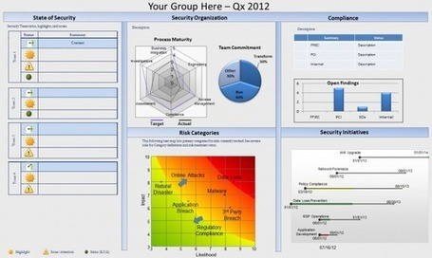
CSOC – Developing Processes
Creating the CSOC Processes
CSOC Processes, Procedures and Workflows developed should be aligned to Corporate ISMS (if it exists)
SECURITY METRIC AND DASHBOARD – EXECUTIVE SUMMARY
Definition of Security Metrics based on Center of Internet Security standards
Security KPI reporting definition
Security Balanced Scorecard and Executive Reporting

Slide 35
Cyber Security Operations Center
You can only monitor what you know ☺

Slide 36
….Know your infrastructure….
You can only monitor what you know ☺
Environments
Location
Device Types
System Types
Security Zones
Demarcation Points
Ingress Perimeters
Data Center
Extranet
WAN

Slide 37
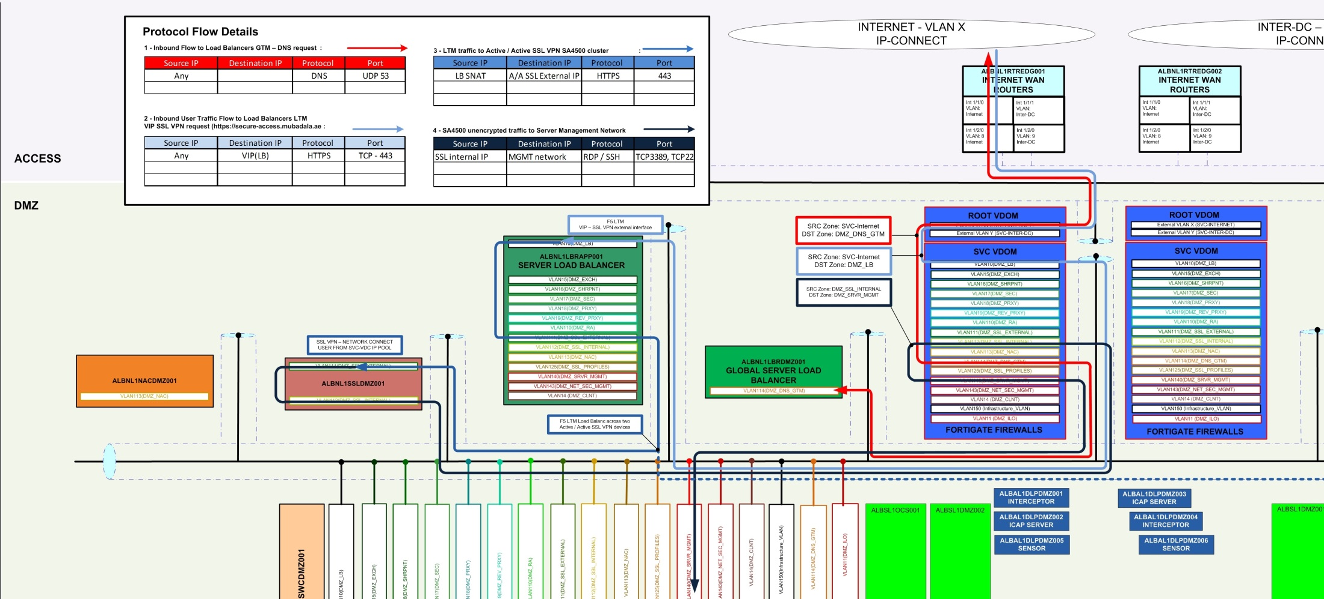
…. Service Flows (Published Services) ……
Knowledge on how service flow across your infrastructure …
BUILD A SECURITY SERVICES CATALOG

Slide 38
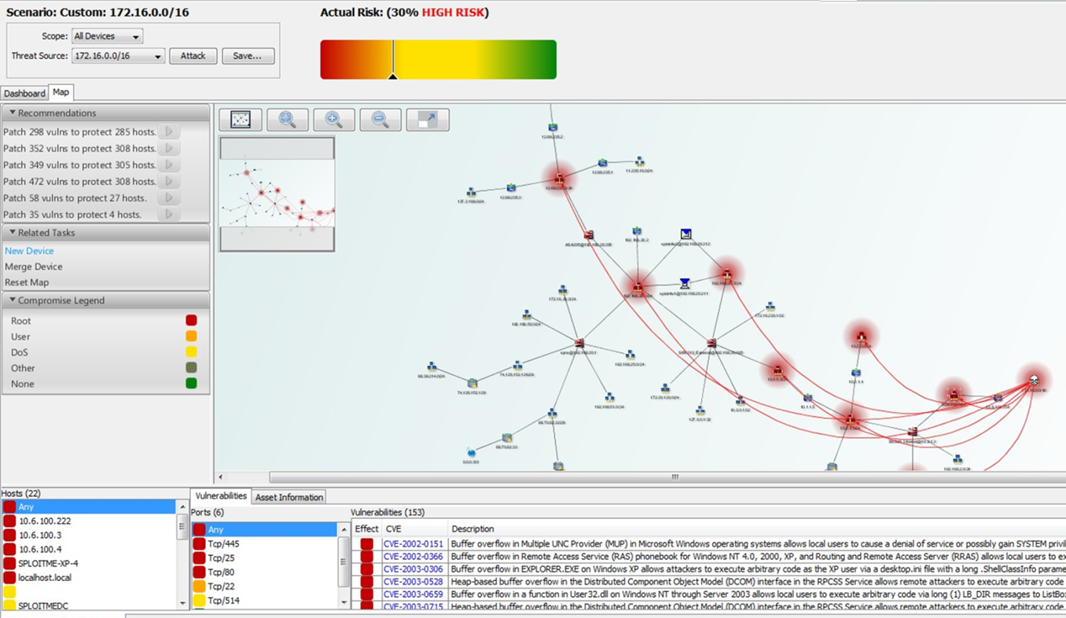
…. Service Flows (Internal Services) ……
Understanding the service flows will allow you to VISUALIZE…
Integration with Vulnerability Management

Slide 39
Build an Asset Repository
Build an Asset Database and Integrated into SIEM;
Following asset details can be adjusted with Asset Manager:
Name
Description
Weight
Operating System
Business Owner
Business Owner Contact Information
Technical Owner
Technical Owner Contact Information
Location
Risk and Vulnerability Information (CVEs)

Slide 40
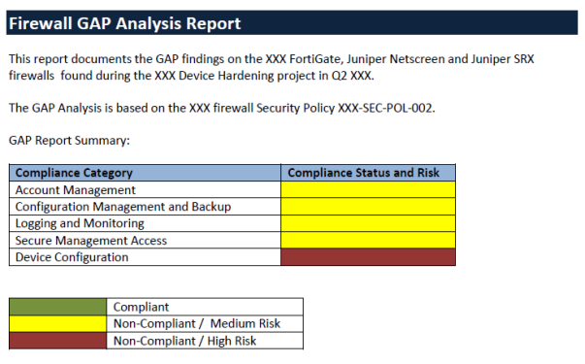
Build Policy Compliance: Firewalls

Slide 41
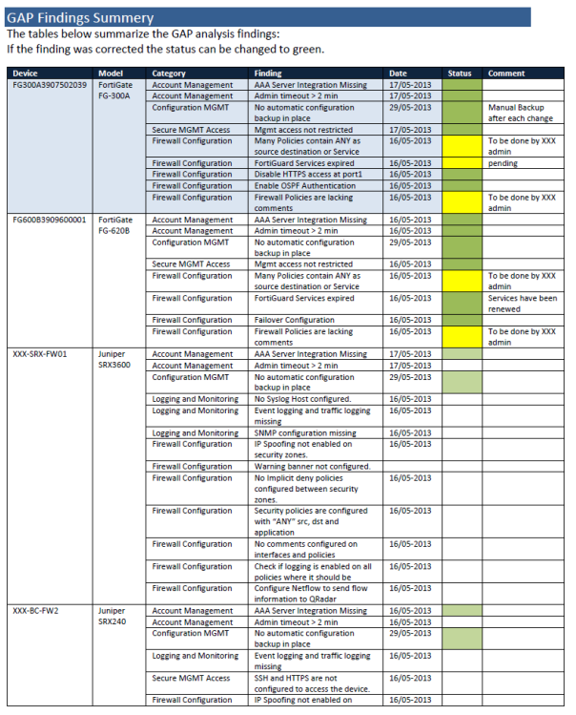
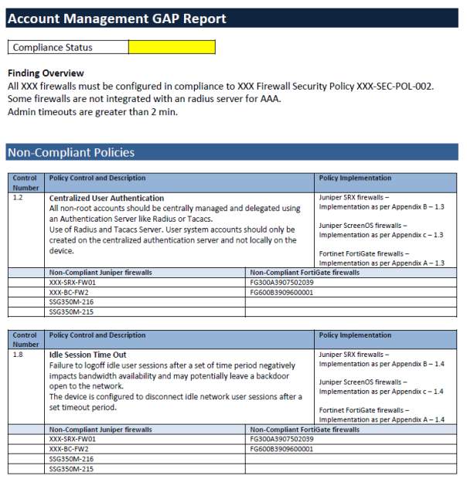
Build Policy Compliance: Firewalls

Slide 42
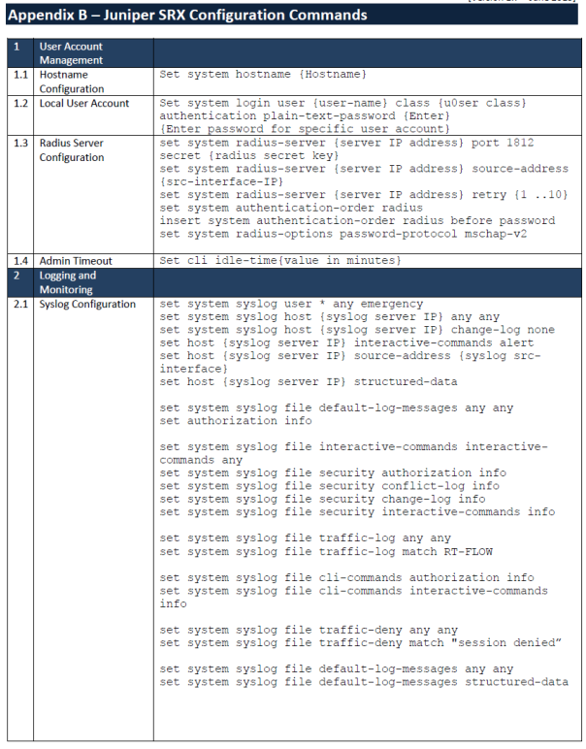
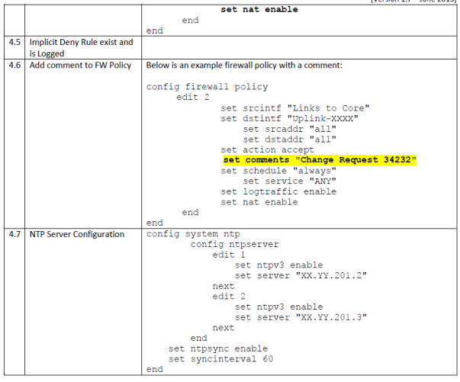
Build Policy Compliance: Firewalls

Slide 43
Develop Threat Cases
Now that we have the processes, technology and people what next…..
Build contextual threat cases per environment;
Extranet
Internet
Intranet
Data Center
Active Directory
Malware / Virus Infection and Propagation
NetFlow Analysis
Remote Sites / WAN
Remote Access – IPSEC VPN / SSL VPN
Wireless
etc…..

Slide 44
Develop Threat Cases
To define threat cases per environment … not by system…. (silo)
CONTEXTUAL
SERVICE ORIENTATED
USER CENTRIC
ID | Threat Case Development
OS.WIN | Microsoft Windows Servers - Threat Case Development Documentation Microsoft Active Directory - Threat Case Development Documentation
MSIIS MSSQL MSEXC | Microsoft Application - Threat Case Development Documentation IIS MSSQL Exchange
IBMAIX LINUX SOLARIS | UNIX/LINUX/SOLARIS/AIX – Threat Case Development Documentation
PRIVACC | Advanced Threat Cases for Privileged User and Special Account Activity and Monitoring
N/A | Baseline Security Settings on UNIX/LINUX/SOLARIS/AIX server
BUSINT | Business Internet
EXTRNT | Extranet
S2SVPN | Site to Site VPN

Slide 45
Advanced threat cases - environment
To define threat cases per environment …
…. Eventually …. Should …. Include …. All …. Environment …..
ID | Threat Case Development
INTOFF | International Offices – Global MPLS
SSLVPN | Juniper SSL VPN
NATIONAL | IPVPN –National MPLS IPVPN
WIRLESS | Wireless Infrastructure
VOIPUC | Voice over IP
VSAT | VSAT – Satellite
DIGPKI | PKI and X.509 Digital Certificates (systems threat case)
AAA | AAA (systems threat case)
HIPS | HIPS and Application Whitelisting
EXECACC | Executive Account Monitoring
SAP | SAP Router and SAP Privilege Activity Monitoring
COMPLIANCE | Compliance and Best Practices Configuration
NAC | Network Admission Control
IPS-AV | IPS and AV Management Console
EMAIL | Email Security – Business Internet Gateway
DAM | Database Activity Monitoring (DAM)
SFT | Secure File Transfer
IMPORTANT – understand the environment and understand the threats related to those environment…..

Slide 46
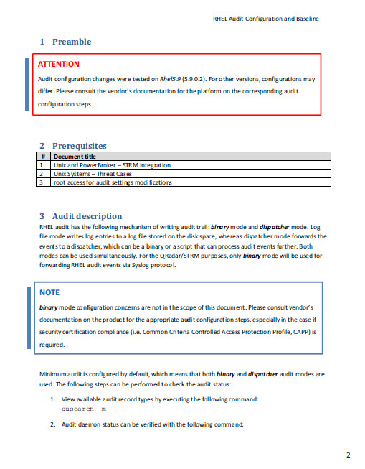
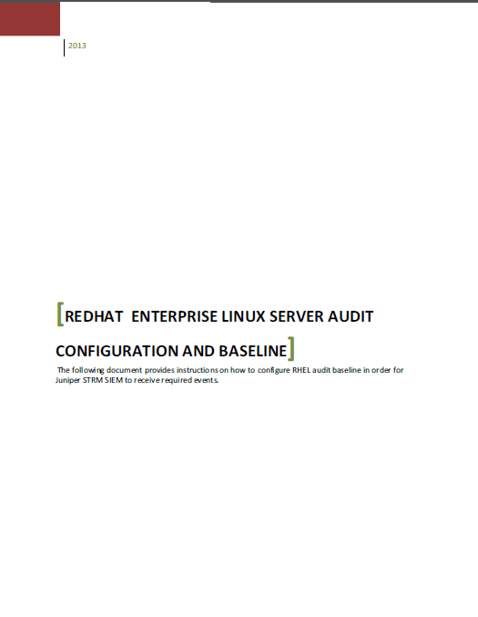
Develop Threat Cases – RHEL

Slide 47
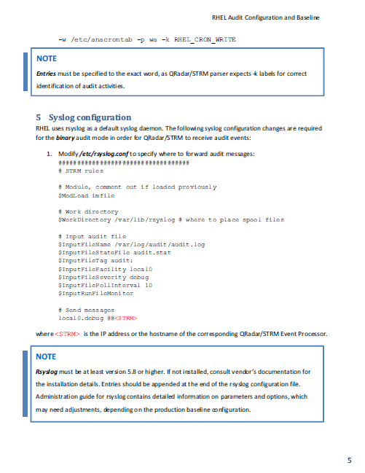
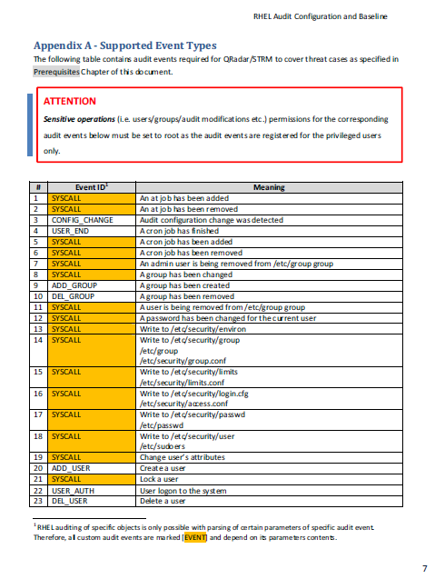
Develop Threat Cases – RHEL

Slide 48
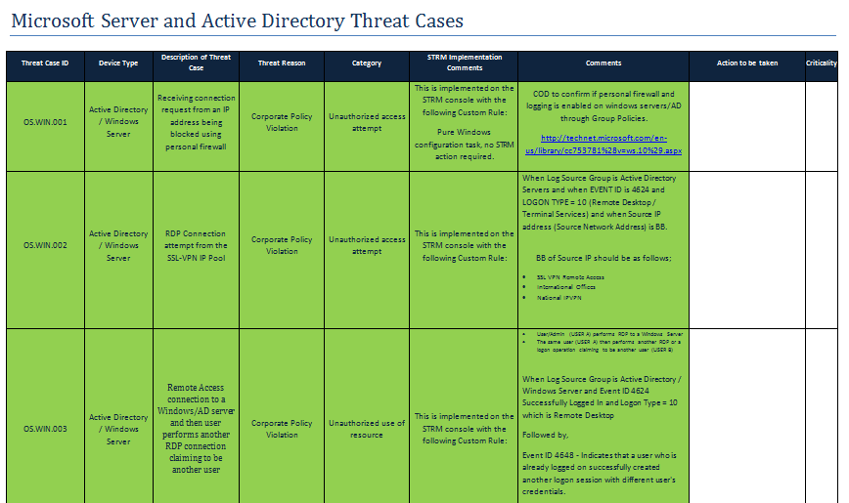
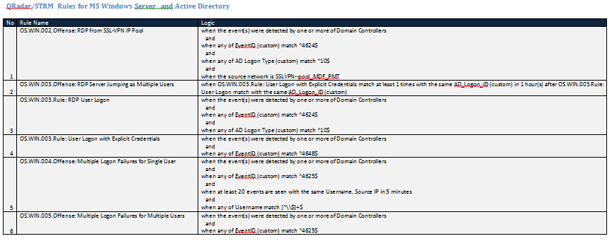
Develop Threat Cases – Windows Servers
Important Note:
"OS.WIN.010.Offense: Multiple Logon for Single User from Different Locations" offense is disabled pending application/system accounts names clarifications to be excluded from the rule's logic.

Slide 49
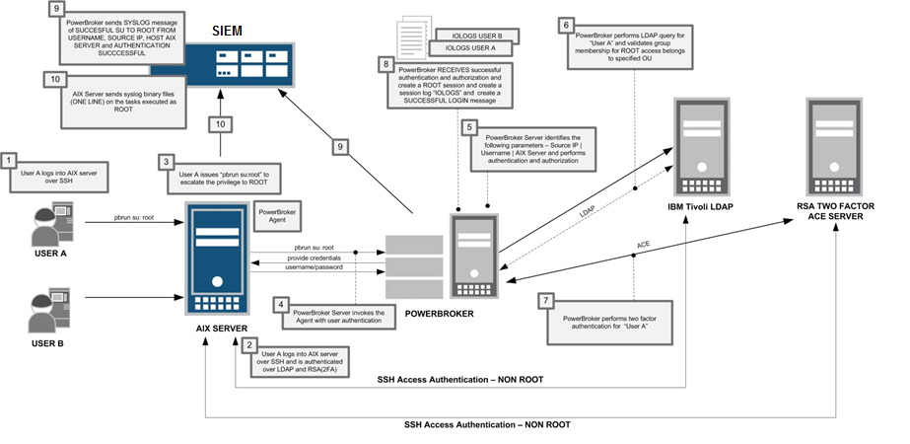
*nix authentication … follow the process

Slide 50
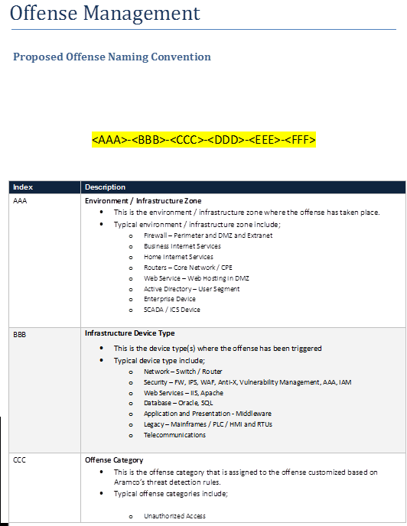
Offense Management Naming Convention

Slide 51
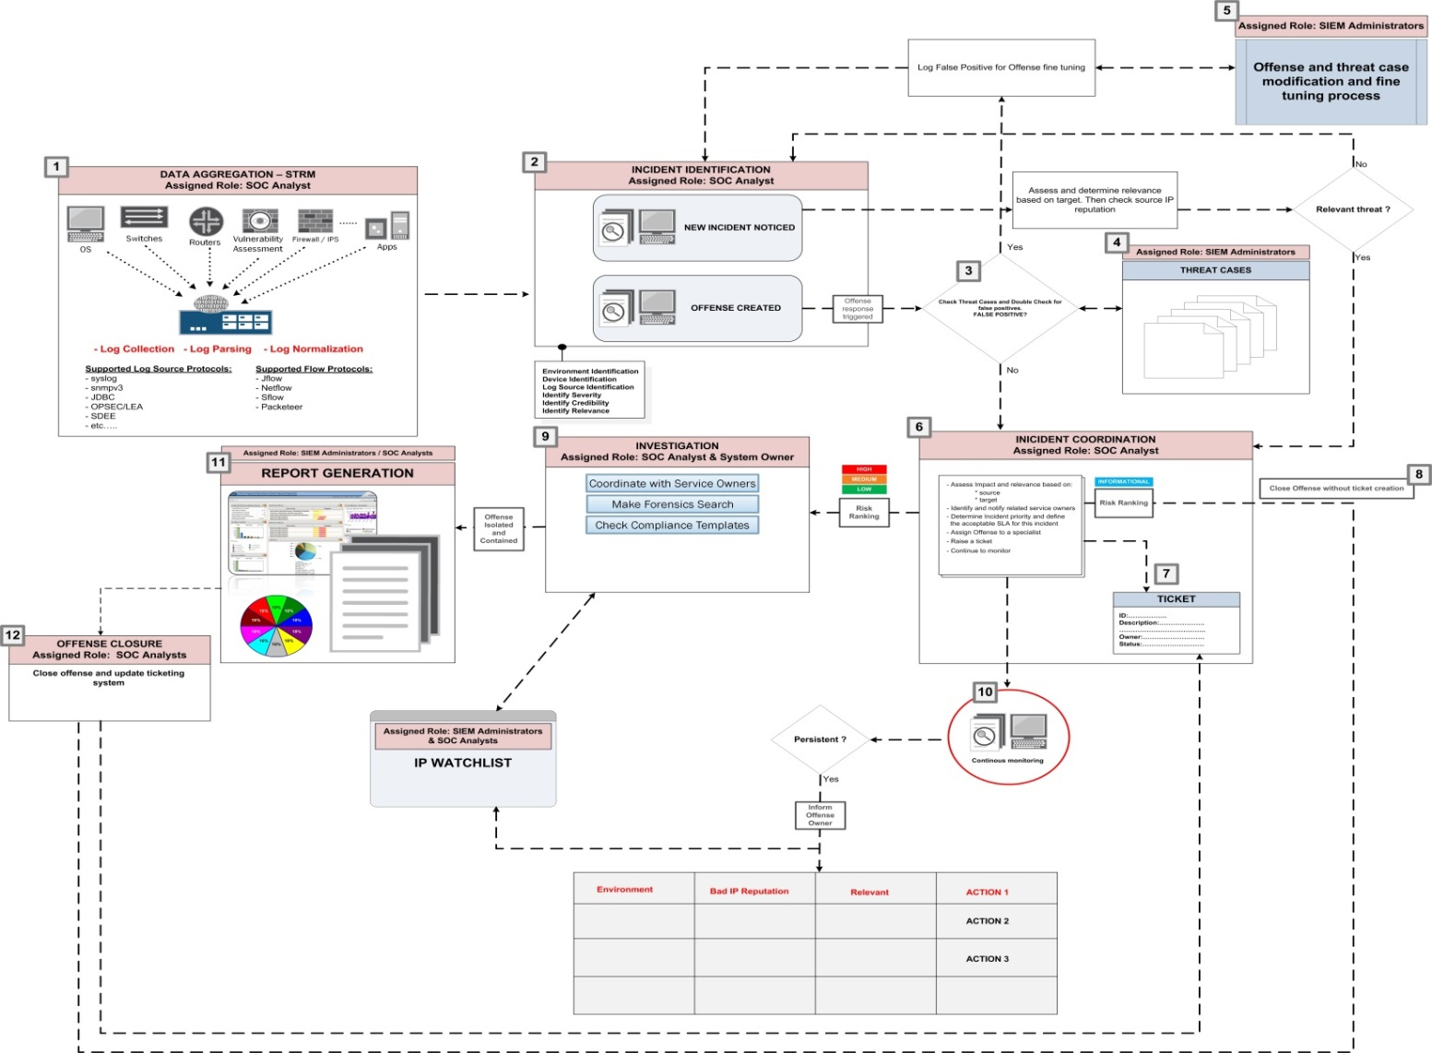
Offense Management Workflow

Slide 52
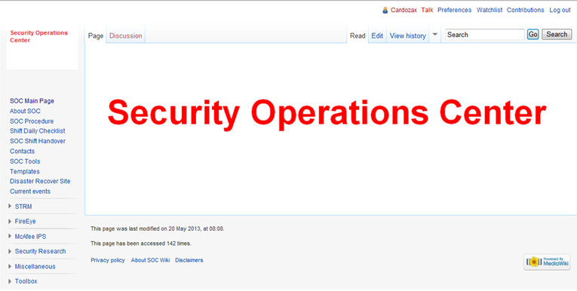
Cyber SOC Wiki
CSOC-Wiki
https://SOC-wiki.intranet.xyz

Slide 53
CSOC-Wiki - Goals
Purpose of the WiKi
Centralized Knowledge Repository for SOC
Collaborate and Share Information with other Team Members
Easy of use and searchable (Google Like)
Integrations with other toolsets
Challenges within CSOC
Current Issues with SIEM Processes, Documentations, Offence Handling, Knowledge Sharing
SIEM Integrations into SOC-Wiki
SIEM Threat Cases

Slide 54
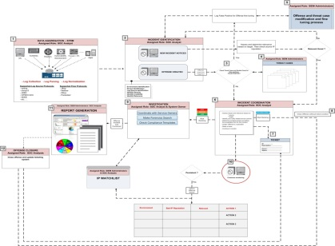
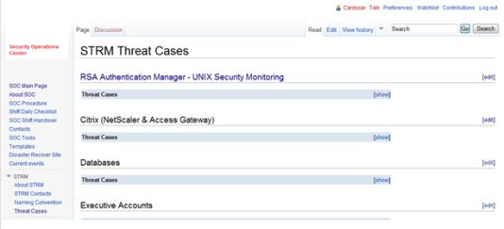
CSOC Wiki – SIEM Integration
Workflows
Processes
CSOC - WiKi
Security Maturity Level
4 to 5
Threat Cases

Slide 55
CSOC Wiki – SIEM Integration

Slide 56
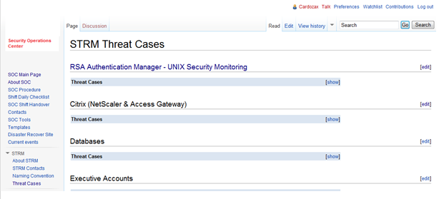
CSOC Wiki – SIEM Integration
SIEM Threat Cases

Slide 57
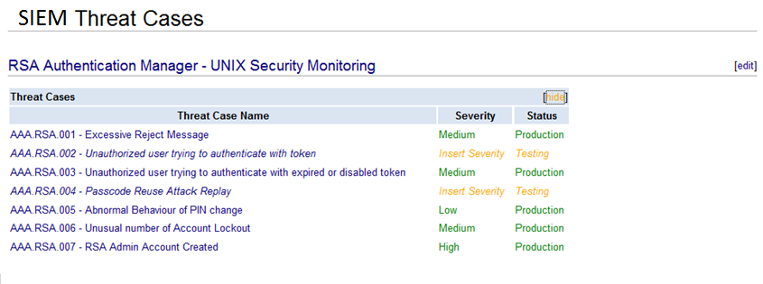
SOC Wiki – SIEM Threat Cases
Listed above is how Threat Cases are displayed in SOC-Wiki
Threat Case Name, Severity, Status
Information - Centralized, Detailed and Searchable
Information updated by SIEM and SOC Teams

Slide 58
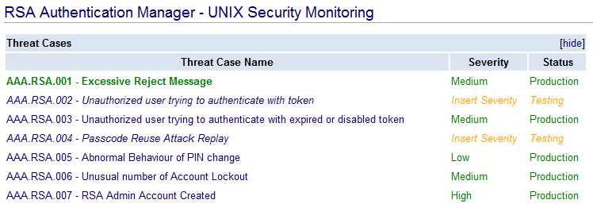
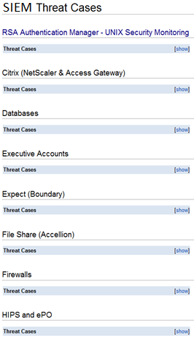
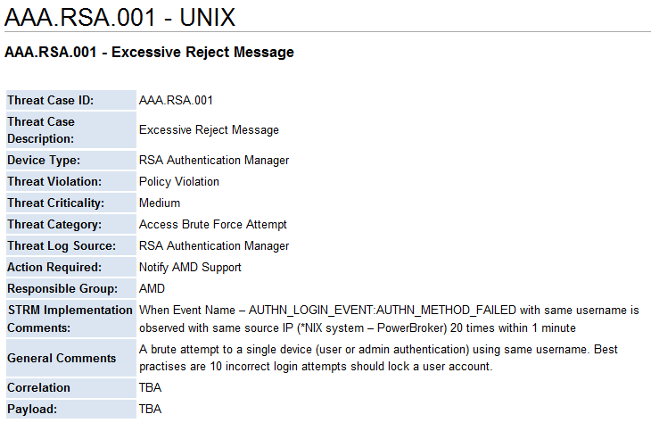
SOC Wiki – SIEM Threat Cases
Example:

Slide 59
Shah H Sheikh – Sr. Security Solutions Consultant
MEng CISSP CISA CISM CRISC CCSK
shah@dts-solution.com

