Slide 1
Threat Intel: DIY
Defcamp #7
Daniel BARBU
Bryson LOUGHMILLER

Slide 2
Disclaimer
(s)
The views and opinions expressed in this presentation are those of the authors and do not necessarily represent the opinions or positions of our employer and/or affiliated organizations.
The presented data was gathered using a public cloud
provider and no employer owned infrastructure was used.
Simple Stuff

Slide 3
Threat Intel
Malware Domains
FireEye
Team CYMRU
I-Blocklist
AlienVault
CrowdStrike
PhishTank
AutoShun
RSA FirstWatch
Threat Stream
FireHol IP Lists
SSL Blocklist
Notes:
https://github.com/hslatman/awesome-threat-intelligence

Slide 4
WHAT? – Why? – How?
Improve the understanding of our adversaries
TTPs
Identities
Leverage existing infrastructure
Organization – Tailored IOCs
Automation!!!

Slide 5
What? - Why? – how?
Too many sources
False Positives
Non Relevant IoCs
Time & Cost
Fails to Identify actors targeting YOU

Slide 6
What? - Why? – how?
Plan:
Invest in people
Understand your environment
Do:
Setup Monitoring tools
Check:
Monitor Accordingly
Suricata & Bro -> Splunk
Act:
Gather IoCs
Develop Alerts
Automate
… REPEAT!

Slide 7
sURICATA
Open Source IDS
Custom Rules Creation
Snort-Based
Multi-Threaded
Automatic protocol detection
HTTP log module
Lua scripting
file matching, logging, extraction, md5 checksum calculation
DNS logger

Slide 8
SET IT UP
Set up on a host which has access to your network tap or span interface
https://redmine.openinfosecfoundation.org/projects/suricata/wiki/Suricata_Installation
sudo suricata -c /etc/suricata/suricata.yaml -i <Net_If> --init-errors-fatal

Slide 9
Bro
Open Source “Network Analysis Framework”
Detailed analysis of common protocols
Provides detailed session data with information about connection state and history
Highly efficient
Customizable

Slide 10
Set it up
Set up on host which has access to tap or span interfaces
https://www.bro.org/sphinx/install/install.html
Managed through broctl:
Broctl start

Slide 11
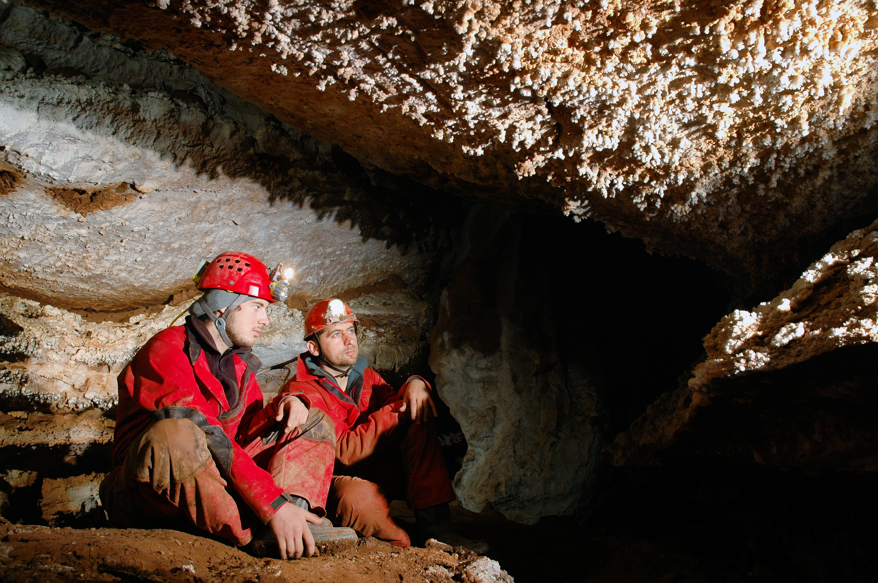
Splunk
Log aggregation tool
Event-based
Search-driven
Highly customizable
Dashboards
And much, much more

Slide 12
SET IT UP
Installed on a host with network access to log forwarders (at its simplest)
https://wiki.splunk.com/Installing_Splunk_in_the_Enterprise_Step_by_Step
https://www.splunk.com/en_us/download/splunk-enterprise-2.html#tabs/linux
./splunk start

Slide 13
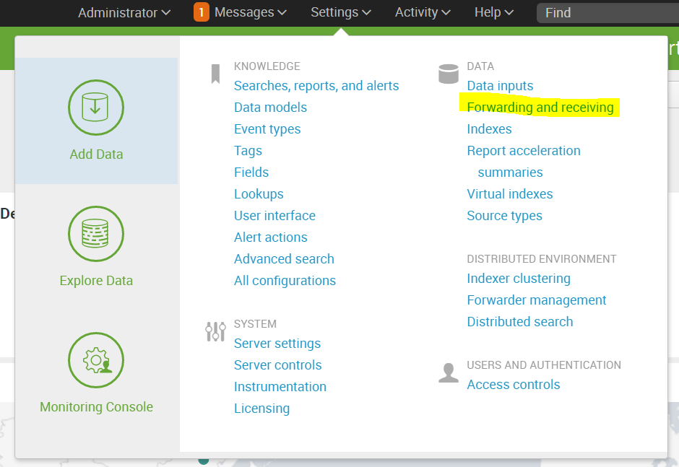
FORWARDING THE LOGS
Set up listener on Splunk
Click “Configure Receiving”
Add a listening port
Point all log traffic to this host and port

Slide 14
FORWARDING THE LOGS
Splunk Universal Forwarder:
Download and install on bro and Suricata hosts:
http://docs.splunk.com/Documentation/Forwarder/6.5.0/Forwarder/Installtheuniversalforwardersoftware
Point to listener:
./splunk add forward-server <host name or ip address>:<listening port>
Point to Logs:
./splunk add monitor /var/log
./splunk add monitor /var/log
Modify /opt/splunkforwarder/etc/system/local
[monitor:///var/log/suricata/eve.json] index = ids

Slide 15
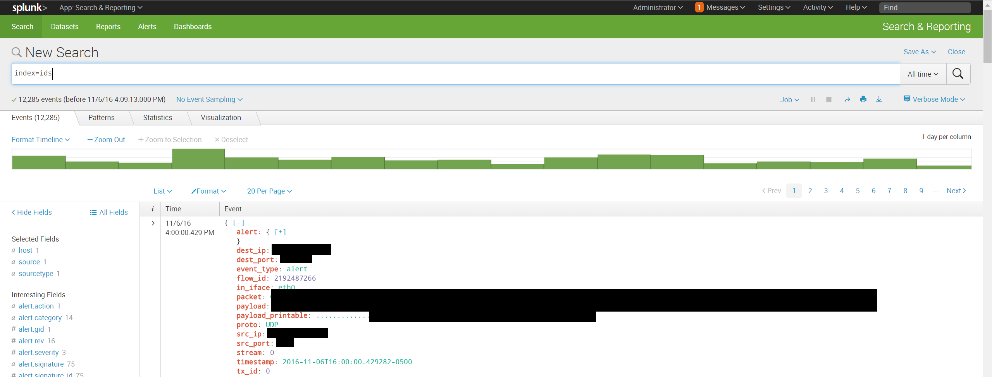
Notes:
Now we can jump into our Splunk instance and see our events beginning to come in

Slide 16
Notes:
Now with this data, we can do some fancy search functions to find legitimate threat actors, and record them.
Here’s the search to pipe into a lookup table

Slide 17
Notes:
Go piece by piece through the search

Slide 18
index=ids src_ip!=172.16.0.0/12 | stats latest(_time) AS last_time, values(alert.signature), dc(dest_ip), dc(alert.signature), count by src_ip | eval last_seen=strftime(last_time,"%m/%d/%y %H:%M:%S") | rename last_seen AS "Last Seen", dc(alert.signature) AS sig_count, src_ip AS "Threat Actor", values(alert.signature) AS "Attack Signature", dc(dest_ip) AS "Num of Targets", count as "Num of Events" | where sig_count > 1 | iplocation "Threat Actor" | eval Location=if(City="", Country, City. ", " .Country) | table last_time, "Last Seen", "Threat Actor", Location, "Attack Signature" | inputlookup append=true threat_actors_ids.csv | dedup "Threat Actor" | outputlookup threat_actors_ids.csv
Notes:
Get rid of all internal addresses – Including your external IP space – don’t want your IP addresses added to the threat list now, do we?

Slide 19
index=ids src_ip!=172.16.0.0/12 | stats latest(_time) AS last_time, values(alert.signature), dc(dest_ip), dc(alert.signature), count by src_ip | eval last_seen=strftime(last_time,"%m/%d/%y %H:%M:%S") | rename last_seen AS "Last Seen", dc(alert.signature) AS sig_count, src_ip AS "Threat Actor", values(alert.signature) AS "Attack Signature", dc(dest_ip) AS "Num of Targets", count as "Num of Events" | where sig_count > 1 | iplocation "Threat Actor" | eval Location=if(City="", Country, City. ", " .Country) | table last_time, "Last Seen", "Threat Actor", Location, "Attack Signature" | inputlookup append=true threat_actors_ids.csv | dedup "Threat Actor" | outputlookup threat_actors_ids.csv
Notes:
Get rid of all internal addresses – Including your external IP space – don’t want your IP addresses added to the threat list now, do we?

Slide 20
index=ids src_ip!=172.16.0.0/12 | stats latest(_time) AS last_time, values(alert.signature), dc(dest_ip), dc(alert.signature), count by src_ip | eval last_seen=strftime(last_time,"%m/%d/%y %H:%M:%S") | rename last_seen AS "Last Seen", dc(alert.signature) AS sig_count, src_ip AS "Threat Actor", values(alert.signature) AS "Attack Signature", dc(dest_ip) AS "Num of Targets", count as "Num of Events" | where sig_count > 1 | iplocation "Threat Actor" | eval Location=if(City="", Country, City. ", " .Country) | table last_time, "Last Seen", "Threat Actor", Location, "Attack Signature" | inputlookup append=true threat_actors_ids.csv | dedup "Threat Actor" | outputlookup threat_actors_ids.csv
Notes:
Now we need to get the latest time we’ve seen the alert, all the signatures we’ve seen in this timeframe, the number of our IP’s that it’s attacking, the count of signatures, and the number of events, all grouped by the srce_ip, the attacker

Slide 21
index=ids src_ip!=172.16.0.0/12 | stats latest(_time) AS last_time, values(alert.signature), dc(dest_ip), dc(alert.signature), count by src_ip | eval last_seen=strftime(last_time,"%m/%d/%y %H:%M:%S") | rename last_seen AS "Last Seen", dc(alert.signature) AS sig_count, src_ip AS "Threat Actor", values(alert.signature) AS "Attack Signature", dc(dest_ip) AS "Num of Targets", count as "Num of Events" | where sig_count > 1 | iplocation "Threat Actor" | eval Location=if(City="", Country, City. ", " .Country) | table last_time, "Last Seen", "Threat Actor", Location, "Attack Signature" | inputlookup append=true threat_actors_ids.csv | dedup "Threat Actor" | outputlookup threat_actors_ids.csv
Notes:
This just simply converts nasty epoch time to human readable time

Slide 22
index=ids src_ip!=172.16.0.0/12 | stats latest(_time) AS last_time, values(alert.signature), dc(dest_ip), dc(alert.signature), count by src_ip | eval last_seen=strftime(last_time,"%m/%d/%y %H:%M:%S") | rename last_seen AS "Last Seen", dc(alert.signature) AS sig_count, src_ip AS "Threat Actor", values(alert.signature) AS "Attack Signature", dc(dest_ip) AS "Num of Targets", count as "Num of Events" | where sig_count > 1 | iplocation "Threat Actor" | eval Location=if(City="", Country, City. ", " .Country) | table last_time, "Last Seen", "Threat Actor", Location, "Attack Signature" | inputlookup append=true threat_actors_ids.csv | dedup "Threat Actor" | outputlookup threat_actors_ids.csv
Notes:
Rename some of those variables so they look a little nicer

Slide 23
index=ids src_ip!=172.16.0.0/12 | stats latest(_time) AS last_time, values(alert.signature), dc(dest_ip), dc(alert.signature), count by src_ip | eval last_seen=strftime(last_time,"%m/%d/%y %H:%M:%S") | rename last_seen AS "Last Seen", dc(alert.signature) AS sig_count, src_ip AS "Threat Actor", values(alert.signature) AS "Attack Signature", dc(dest_ip) AS "Num of Targets", count as "Num of Events" |where sig_count > 1| iplocation "Threat Actor" | eval Location=if(City="", Country, City. ", " .Country) | table last_time, "Last Seen", "Threat Actor", Location, "Attack Signature" | inputlookup append=true threat_actors_ids.csv | dedup "Threat Actor" | outputlookup threat_actors_ids.csv
Notes:
Only get those actors which have fired on more than one signature.

Slide 24
index=ids src_ip!=172.16.0.0/12 | stats latest(_time) AS last_time, values(alert.signature), dc(dest_ip), dc(alert.signature), count by src_ip | eval last_seen=strftime(last_time,"%m/%d/%y %H:%M:%S") | rename last_seen AS "Last Seen", dc(alert.signature) AS sig_count, src_ip AS "Threat Actor", values(alert.signature) AS "Attack Signature", dc(dest_ip) AS "Num of Targets", count as "Num of Events" | where sig_count > 1 | iplocation "Threat Actor" | eval Location=if(City="", Country, City. ", " .Country) | table last_time, "Last Seen", "Threat Actor", Location, "Attack Signature" | inputlookup append=true threat_actors_ids.csv | dedup "Threat Actor" | outputlookup threat_actors_ids.csv
Notes:
Cool little trick in Splunk to get the geolocation of an IP address – And then, combine the country and city into a single field (could remain separated if you’d like)

Slide 25
index=ids src_ip!=172.16.0.0/12 | stats latest(_time) AS last_time, values(alert.signature), dc(dest_ip), dc(alert.signature), count by src_ip | eval last_seen=strftime(last_time,"%m/%d/%y %H:%M:%S") | rename last_seen AS "Last Seen", dc(alert.signature) AS sig_count, src_ip AS "Threat Actor", values(alert.signature) AS "Attack Signature", dc(dest_ip) AS "Num of Targets", count as "Num of Events" | where sig_count > 1 | iplocation "Threat Actor" | eval Location=if(City="", Country, City. ", " .Country) | table last_time, "Last Seen", "Threat Actor", Location, "Attack Signature" | inputlookup append=true threat_actors_ids.csv | dedup "Threat Actor" | outputlookup threat_actors_ids.csv
Notes:
Append rows that don’t already exist to the table so we can keep old indicators that weren’t newly generated by this lookup

Slide 26
index=ids src_ip!=172.16.0.0/12 | stats latest(_time) AS last_time, values(alert.signature), dc(dest_ip), dc(alert.signature), count by src_ip | eval last_seen=strftime(last_time,"%m/%d/%y %H:%M:%S") | rename last_seen AS "Last Seen", dc(alert.signature) AS sig_count, src_ip AS "Threat Actor", values(alert.signature) AS "Attack Signature", dc(dest_ip) AS "Num of Targets", count as "Num of Events" | where sig_count > 1 | iplocation "Threat Actor" | eval Location=if(City="", Country, City. ", " .Country) | table last_time, "Last Seen", "Threat Actor", Location, "Attack Signature" | inputlookup append=true threat_actors_ids.csv |dedup "Threat Actor" | outputlookup threat_actors_ids.csv
Notes:
Remove the duplicates and push them out to a new lookup table

Slide 27
Scheduled searches
Set up a Scheduled search to populate threat list every day

Slide 29
Demo

Slide 30
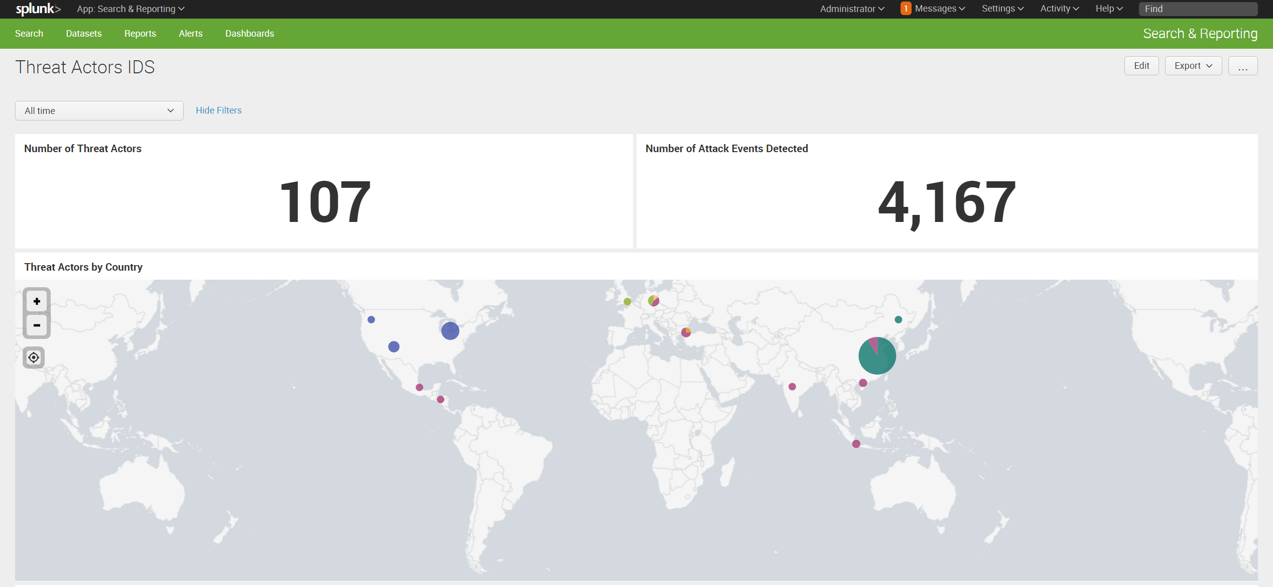

Slide 31
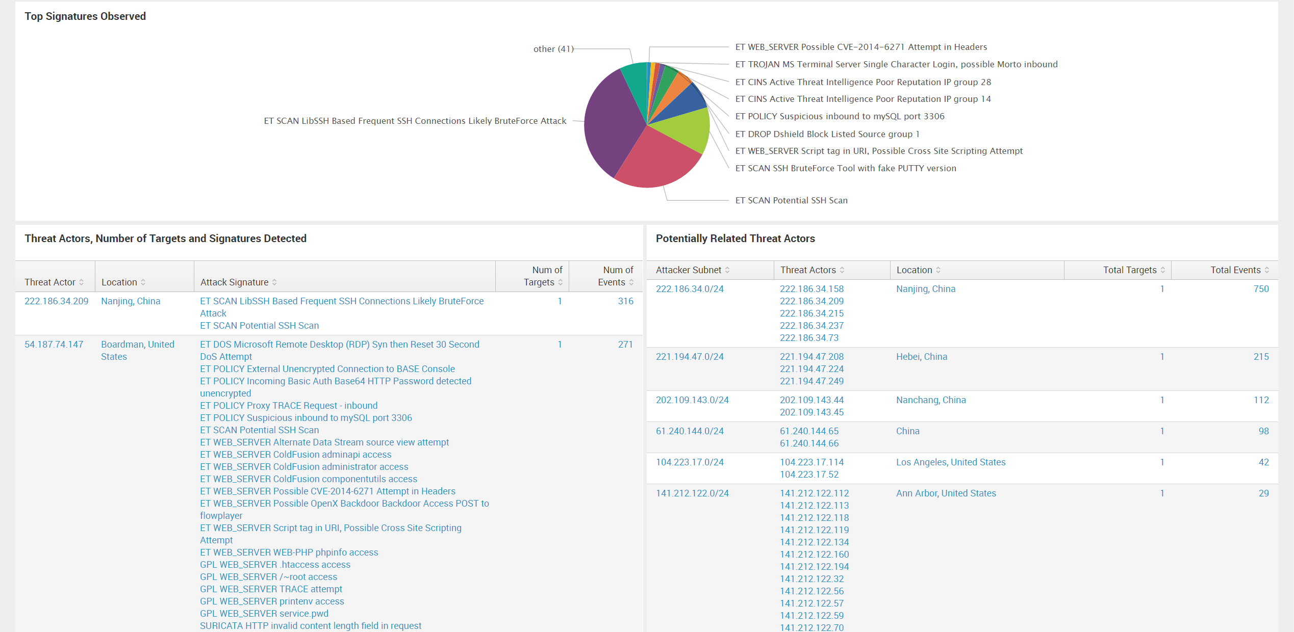

Slide 32
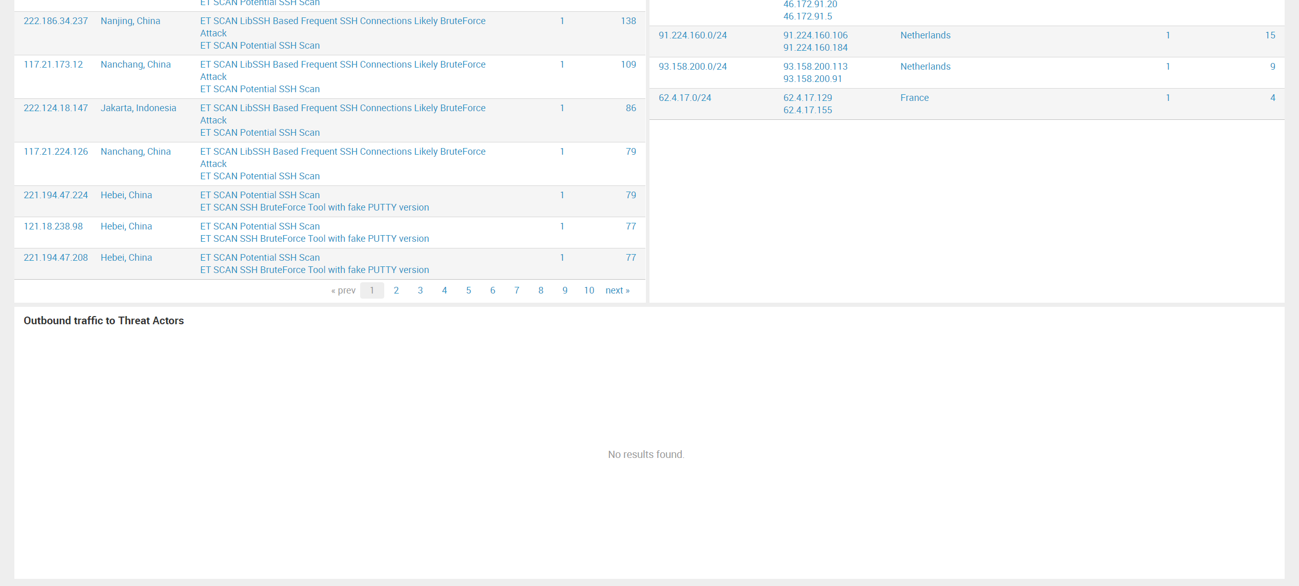

Slide 33
Number of Threat Actors
index=ids src_ip!=172.16.0.0/12 | stats dc(alert.signature) by src_ip | rename dc(alert.signature) as sig_count | where sig_count > 1 | stats count(src_ip)

Slide 34
Threat actors by country
index=ids src_ip!=172.16.0.0/12 | stats values(alert.signature), dc(dest_ip), dc(alert.signature), count by src_ip | rename dc(alert.signature) AS sig_count, src_ip AS "Threat Actor", values(alert.signature) AS "Attack Signature", dc(dest_ip) AS "Num of Targets", count as "Num of Events" | where sig_count > 1 | iplocation "Threat Actor" | stats by "Threat Actor", lat, lon, City, Country, Region | geostats globallimit=5 latfield=lat longfield=lon count by Country

Slide 35
Top signatures observed
index=ids [search index=ids src_ip!=172.16.0.0/12 | stats dc(alert.signature) by src_ip | rename dc(alert.signature) as sig_count | where sig_count > 1 | table src_ip] | stats count by alert.signature | sort count

Slide 36
Threat actors, number of targets, and signatures detected
index=ids src_ip!=172.16.0.0/12 | stats values(alert.signature), dc(dest_ip), dc(alert.signature), count by src_ip | rename dc(alert.signature) AS sig_count, src_ip AS "Threat Actor", values(alert.signature) AS "Attack Signature", dc(dest_ip) AS "Num of Targets", count as "Num of Events" | where sig_count > 1 | iplocation "Threat Actor" | eval Location=if(City="", Country, City. ", " .Country) | table "Threat Actor", Location, "Attack Signature", "Num of Targets", "Num of Events" | sort -"Num of Events"

Slide 37
Potentially related threat actors
index=ids src_ip!=172.16.0.0/12 | rex field=src_ip "(?<subnet>\d+\.\d+\.\d+)\.\d+" | stats dc(alert.signature), values(subnet), values(dest_ip), count by src_ip | rename dc(alert.signature) AS sig_count, src_ip AS "Threat Actor", count as "Num of Events", values(subnet) AS "Subnet", values(dest_ip) AS "Num of Targets" | where sig_count > 1 | stats values("Threat Actor"), count("Threat Actor"), sum("Num of Events"), dc("Num of Targets"), by Subnet | rename count("Threat Actor") as num_actors, sum("Num of Events") as "Total Events", values("Threat Actor") as "Threat Actors", dc("Num of Targets") as "Total Targets" | where num_actors > 1 | eval "Attacker Subnet" = Subnet. ".0/24", first_ip=Subnet. ".1" | iplocation first_ip | eval Location=if(City="", Country, City. ", " .Country) | table "Attacker Subnet", "Threat Actors", Location, "Total Targets", "Total Events"| sort -"Total Events"

Slide 38
Conclusions – Takeaways
Easy to Set up
Valuable data
Less False Positives
Relevant IoCs
Time & Cost
Identifies actors targeting YOU

Slide 39
THANK YOU!

