Slide 1
Securing Mobile Cryptocoin Wallets
Challenges of implementing a secure mobile cryptocurrency wallet

Slide 2
cat /home/chris/bio.txt
I started as a (mostly) C++ developer – 4 yrs.
Moved on to mobile game development
Here I discovered the challenges of securing apps against motivated attackers (cheaters 😐)
Also 4 yrs.…
In the past 1 ½ year I have been working on delivering Blockchain based solutions to financial institutions

Slide 3
Blockchain Business: What it feels like (sometimes)

Slide 4
Blockchain vs Business
The blockchain systems were designed for storing transaction information publicly
Most financial institutions want to keep their ledgers private
Blockchains were meant to run on computers around the world, heavily distributed to prevent subversion by one single party
Financial institutions want to run servers secured in their own data centers
Trust between financial entities is low
BUT things will change (probably)
Many big companies are already experimenting with blockchains (Microsoft, IBM, NASDAQ and others) and looking for viable business cases

Slide 5
Onto The Fun Stuff…

Slide 6
A Galaxy of Cryptocoins

Slide 7
Do You Use Bitcoin?
If Yes:
How do you keep your wallet safe?
What devices do you trust to keep your funds safe?
Do you have multiple addresses: hot/cold wallets?
Do you think Bitcoin is easy ☺?
If Not:
Would you like to buy 1 BTC for 100$? Me too!

Slide 8
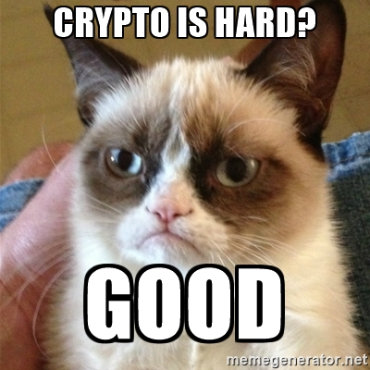
Bitcoin isn't easy to use because...
Cryptography is hard(to use/understand)
A balance must be struck between usability and security
Secrets must be kept… secret
It must offer total user control

Slide 9
Existing Mobile Wallet Apps
Bither (https://bither.net)
iOS only
Cold & hot wallet approach
Password based deterministic wallet
Breadwallet (http://breadwallet.com)
BIP39(Bitcoin Improvement Proposal) mnemonic based deterministic wallet
Vulnerable on jailbroken devices(the keychain is a file!)

Slide 10
Existing Mobile Wallet Apps (Cont’d)
GreenAddress(https://greenaddress.it)
Also BIP39 mnemonic phrase based
2-factor auth: email, one time password, SMS
Relies on a second signature from GreenAddres's servers
ETC
More wallets based on a 2 component method of authentication and a centralized server

Slide 11
All This is Good But…
Existing solutions either require the user to write down/store securely(how?) a complicated secret
Or rely on an external authentication provider
Or both
So: not easy to use and/or potentially insecure
Still, the level of usability/security is reasonable

Slide 12
I Think We Can Improve on Existing Designs

Slide 13
All You Have To Do Is…
Take a greenfield approach(I learned a new word recently)
Be willing to change the protocol (yup, this is the hard part!)
Leverage existing security hardware improvements in mobile devices

Slide 14
Security Hardware in Mobile Devices
Biometric sensors
Fingerprint sensors mostly
Hardware accelerated crypto
iOS: Common Crypto & the Security Framework (A7 chip and newer)
Android: ARMv8-A devices(64-bit)
The A7’s Secure Enclave
Secure Element in some Android phones
(Atmel ATECC508A chip for embedded devices)

Slide 15
Proposed Usage of the A7’s Secure Enclave
Starting with the iPhone 5s(A7 CPU), Apple includes a “Secure Enclave”
Can be used in conjunction with the Security framework
Can store keychain items(password, secrets etc.)
Should be tamper proof, hardware wise (or very hard to crack)
Makes brute forcing the device’s password/PIN code harder
Can generate an ECDSA key pair, store it and sign with it inside the Enclave without ever having the private key leave the Secure Enclave chip memory
Since this is using the Security framework, anything stored in the Secure Enclave will not survive a device wipe(iOS Keychain)
P.S. Please don’t store your keys in iCloud ☺

Slide 16
So in Theory…
We could generate a Bitcoin/Ethereum/Ripple/YourCoolAltcoin wallet key pair in the Secure Enclave
All transactions would be signed in the Enclave without ever exposing the private key
Your iPhone would act as a secure hardware wallet
You could use your fingerprint or your device password (preferably not a 4 digit PIN) to unlock your wallet
It should not be vulnerable on jailbroken devices (the private key is not stored in the regular keychain which is a file on disk and which is decrypted when the device is unlocked…)
The private key never enters regular RAM so it should be safe from many types of on-device attacks
The Secure Enclave should be pretty secure against software based attacks in general

Slide 17
Before We Get Started
The Secure Enclave offers no protection against bad code… ☺
We need to secure any private key saved in the Secure Enclave by:
Making it inaccessible when the device is locked
Unlock access to it with Touch ID and/or device passcode
Touch ID (fingerprint) is obviously very convenient but can be spoofed as it has been widely demonstrated so… be careful

Slide 18
The CODE(1)
Setup access to be available only when unlocked and with TouchID
Generate the key pair in the Secure Enclave
Request an ECDSA pair of 256 bits size

Slide 19
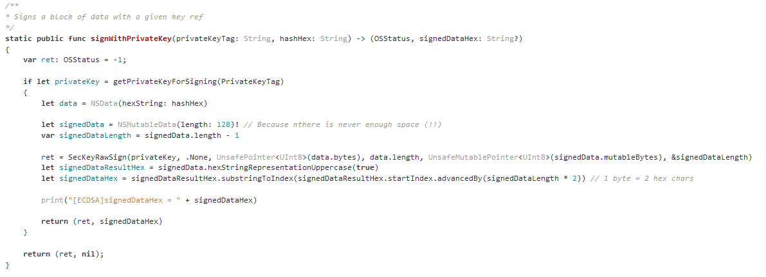
The CODE(2)
Signing: the private key here is only an opaque reference to the private key stored in the Secure Enclave

Slide 20
The Catch!
The ECDSA algorithm supported by iOS is ECDSA for the curve Secp256r1(a.k.a. NIST P-256)
Bitcoin and all altcoins use Secp256k1
The client would need to be modified to allow for transactions signed in this manner
The change is not hard to do but will it be accepted by the community?
Supposedly P-256 has an NSA backdoor (?!)
Alternatively, this can be used in a private enterprise blockchain network or a testnet where this feature is needed

Slide 21
Circling Around
Again, this is a mismatch between the cryptocurrency communities and the enterprise oriented tools and environments
The standard is P-256 but Satoshi used Secp256k1
All cryptocoins followed the same design
Can we all just get along?

Slide 22
Source Code
Modified Ripple client to use Secp256r1 for addresses and signatures:
https://github.com/crazyquark/rippled/tree/secp256r1
iOS App Code:
https://github.com/crazyquark/keysafe

Slide 23
A Geeky Demo

Slide 24
Demo (2) P.S. The transaction data is hardcoded

Slide 25
Q & A

