Slide 1
Secure the Openness The operator challenge
Vlad Sorici, Architecture & Services Project Manager
DefCamp - November 10th, 2016

Slide 2
agenda
What’s the challenge
Captive portal authentication
SIM based authentication
VoWi-Fi security
Localized Wi-Fi attacks

Slide 3
5 fundamental values that should guide everything we do
Simple
Open
Surprising
Dynamic
Honest
So… how can you make this secure?

Slide 4
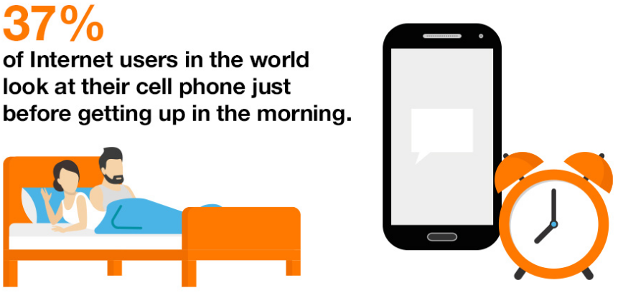
A hyper-connected society
Internet users spend 4.8 hours online each day on their computers and 2.1 hours online on their cell phones

Slide 5
A hyper-connected world using Wi-Fi
Smart TVs
Home appliances
Smart watches
Scales
Connected cars
Video cameras
Music player

Slide 6
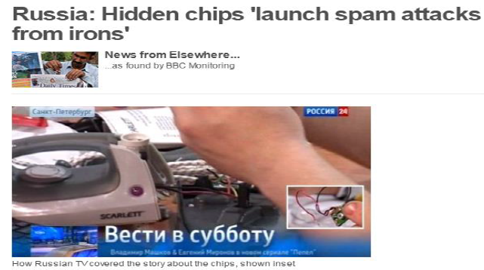
even connected irons …used by spies
The BBC reports a Russian group has uncovered embedded Wi-Fi enabled cards inside an iron
Apparently it would attach to nearby unprotected Wi-Fi and insert a virus whose purpose is not yet known
It is great to see Wi-Fi a tool for everyone – including spies! ☺

Slide 7
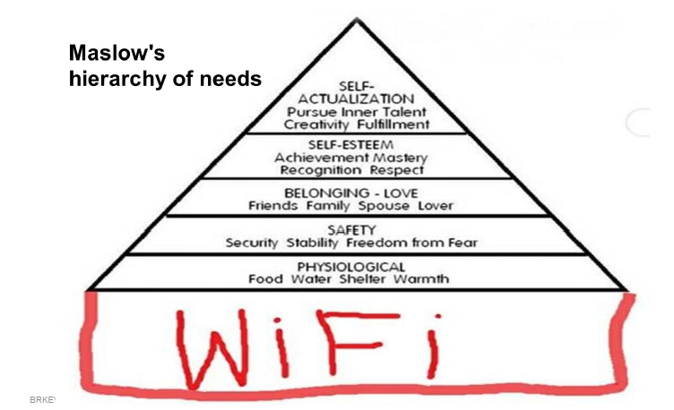
Wi-Fi networks are a big part of the connected world
What’s Wi-Fi?
based on 802.11 standards
What ‘s the general expectation of Wi-Fi?
Free
Open
Always working, always fast

Slide 8
Wi-Fi networks are not as simple as we would like to think or else, everybody could do it
Orange Wi-Fi network now
5.000 Access Points
30.000 simultaneous clients
273.117 monthly users
3 TB average daily traffic
Wi-Fi Services
Operator Wi-Fi (Public)
Business Wi-Fi (B2B and B2B2C)
Business Mobile Wi-Fi
Business Retail Analytics
VoWi-Fi – Apel Wi-Fi

Slide 9
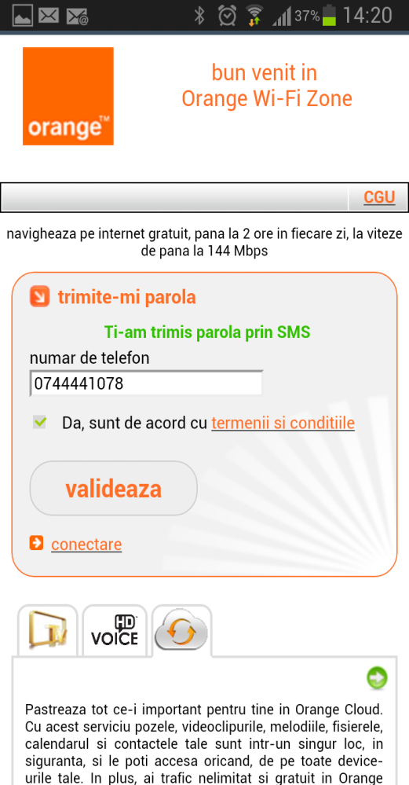
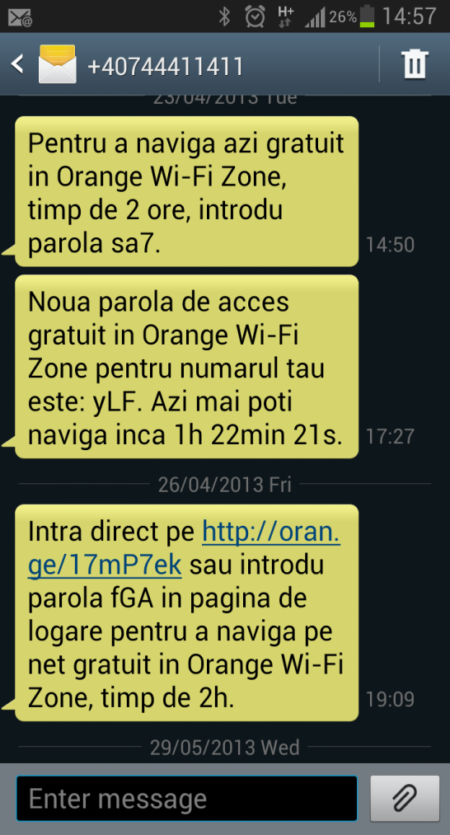
1st challenge create a public Wi-Fi infrastructure secure and easy to connect
Captive portal authentication
SSID appears as “open” to the customers
User connects to the network and opens browser
Redirection to a captive portal where he inputs their phone number
An SMS will be received with the password or authentication URL

Slide 10
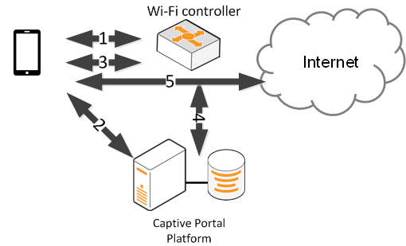
1st challenge basic authentication scheme
Device connects to network and tries to connect to http server and the Wi-Fi controller redirect it to captive portal platform
User authenticates on th
e captive portal and HTTPS authentication is performed
the captive portal will indicate the controller URL that the user will access
After the authentication, the user has now internet access
Device connects to network and tries to connect to http server and the Wi-Fi controller redirect it to captive portal platform
User authenticates on the captive portal and HTTPS authentication is performed
the captive portal will indicate the controller URL that the user will access
The controller URL will trigger the Radius Request according to user data and the captive portal should accept the request

Slide 11
Captive portal authentication create a public Wi-Fi infrastructure secure and easy to connect
Open & Simple
SSID is open so client will try to connect
Only one information requested in the captive portal, with password received instantly
Available to both mobile and desktop devices
Some devices will not open automatically the browser so the client might not know that they need to connect
Requires some manual configuration from the customer
Security
only verified customers can connect
Traffic with captive portal might not be encrypted (+ use HTTPS on the captive portal)
Network traffic not encrypted
Open to AP impersonation attack to gain access to client phone number (+ use HTTPS on the captive portal but requires educated user)

Slide 12
2nd challenge: more open & simple and more secure What? more open & simple AND more secure ?
Open & simple
Automate the connection process
Use existing credentials
Secure
Use WPA2 encryption
Use 802.1x authentication

Slide 13
2nd challenge: more simple and open SIM based authentication
EAP-SIM [RFC 4186] or EAP-AKA [RFC 4187] are authentication methods that are using the SIM credentials stored in the phone
The user doesn’t have to introduce anything
First time set-up where user selects the authentication method, after that, the connection is automatic, just like home
Automatic connection from the beginning for devices supporting Passpoint technology
The permanent identity that is used is the IMSI stored in the SIM card and Wi-Fi key is negotiated without user intervention

Slide 14
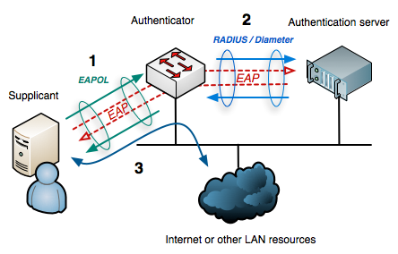
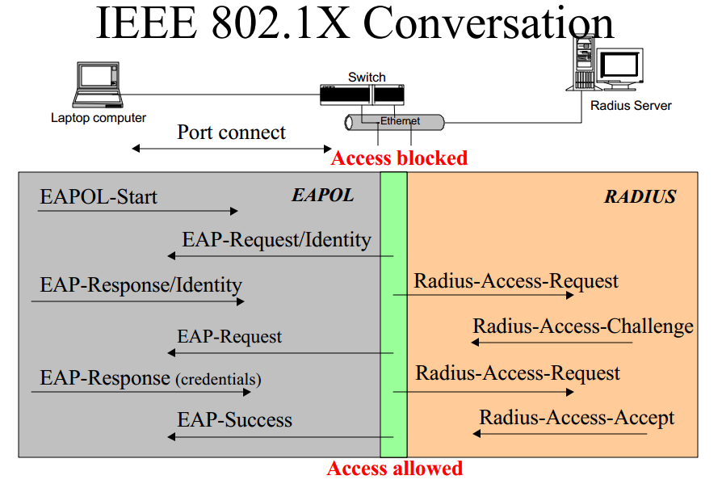
2nd challenge: more secure 802.1x authentication
Most secure authentication method in Wi-Fi
802.1x encapsulates between supplicant and authenticator
RADIUS encapsulates between supplicant and authenticator
Each protocol that uses EAP defines a way to encapsulate EAP messages within that protocol's messages. Main EAP methods: LEAP, TLS, TTLS, SIM, AKA
Remote Authentication Dial In User Service (RADIUS) is a networking protocol that provides centralized Authentication, Authorization, and Accounting (AAA) management for users that connect and use a network service.

Slide 15
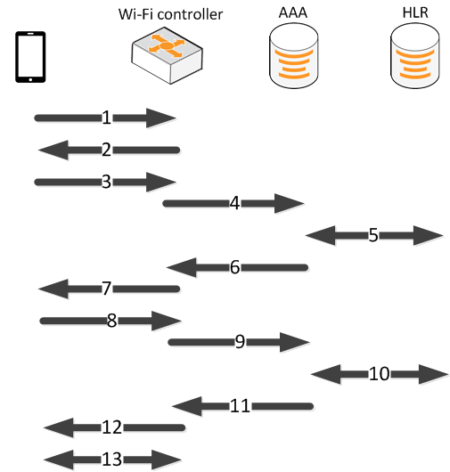
SIM based authentication : EAP-SIM [RFC 4186]
802.1x: EAP-Response/Identity (IMSI)
802.1x: EAP-Request/SIM/Start (AT_VERSION_LIST)
802.1x : EAP-Response/SIM/Start (AT_NONCE_MT, AT_SELECTED_VERSION)
RADIUS: <<above>> (contains also IMSI in RADIUS AVP)
MAP: authentication triplets retrieval (works also for quintets)
RADIUS: EAP-Request/SIM/Challenge (AT_RAND, AT_MAC)
802.1x : <<above>>-> Device runs GSM algorithms, verifies AT_MAC and derives session key
802.1x : EAP-Request/SIM/Challenge (AT_MAC)
RADIUS: <<above>>
[optional] User profile retrieval
RADIUS: EAP-Success 12. 802.1x: EAP-Success
Further key negotiation based on PMK

Slide 16
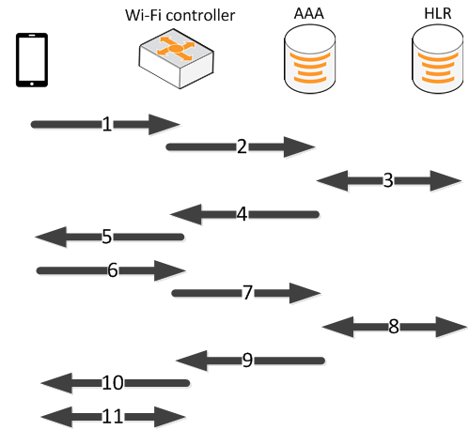
SIM based authentication : EAP-AKA [RFC 4187]
802.1x: EAP-Response/Identity (IMSI)
RADIUS: <<above>>
MAP: authentication quintets retrieval. Server runs AKA algorithms, generates RAND and AUTN)
RADIUS: EAP-Request/AKA-Challenge (AT_RAND, AT_AUTN, AT_MAC)
802.1x : <<above>>-> Device runs runs AKA algorithms verifies AUTN and MAC, derives RES and session key
802.1x : EAP-Request/AKA/Challenge (AT_RES, AT_MAC)
RADIUS: <<above>>: Server checks the given RES and MAC and finds them correct.|
[optional] User profile retrieval
RADIUS: EAP-Success 12. 802.1x: EAP-Success
Further key negotiation based on PMK

Slide 17
SIM based authentication how secure is it?
Basic EAP protocol is not encrypted
Currently EAP-SIM/AKA in EAPOL is unencrypted
Thus IMSI is visible (to a passive attacker) when permanent identity used for full authentication
SOLUTION: use Pseudonym identity (derived by
both the Device and AAA server)
BUT REMEMBER Smartphones will connect automatically to SIM based authentication hotspots so an active attacker might reuse Orange SSID to require full authentication ID
SOLUTION: devices should implement the
“conservative peer policy”, that only respond to
requests for permanent identity when no
pseudonym identity available

Slide 18
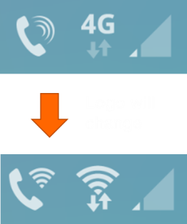
VoWi-Fi what is it?
User experience
Enable Wi-Fi calling
Connect to a Wi-Fi network
Logo will automatically change when Wi-Fi calling is on
You can now call using Wi-Fi internet access

Slide 19
VoWi-Fi what is it?
Technical facts
SIP based calling using Operator IMS infrastructure
Access to the IMS needs to be secure so the device will create an IPSEC tunnel to the ePDG
IKEv2 authentication will be used encapsulating same EAP-AKA authentication
ePDG will authenticate the user through a Diameter interface with the AAA
After the authentication, the ePDG will create a GTPv2 tunnel inside the mobile core

Slide 20
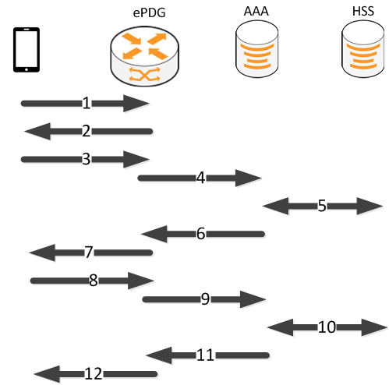
VoWi-Fi authentication phase
IKE_SA_INIT_REQ (SA, DH, Nonces, [NAT detection])
IKE_SA_INIT_RESP (SA, DH, Nonces, [NAT detection])
IKEv2_AUTH_REQ (SA, NAI <<containg IMSI>> , APN, CNFG)
Diameter-EAP Request (NAI, APN): EAP Response
AAA authentication vector retrieval
Diameter-EAP Answer: EAP-Request/AKA-Challenge (AT_RAND, AT_AUTN, AT_MAC)
KEv2_AUTH_RESP: <<above>>
IKEv2_AUTH_REQ: EAP-Request/AKA/Challenge (AT_RES, AT_MAC)
Diameter-EAP Request: <<above>> Server checks the given RES and MAC and finds them correct.|
[optional] User profile retrieval & AAA update in HSS
Diameter-EAP Answer: EAP-Success, EAP-MSK, APN config
KEv2_AUTH_RESP: EAP Success
Notes:
Initiates connection in two phases
• IKE_SA_INIT
• Negotiate cryptographic algorithms, exchange nonces, and do
a Diffie-Hellman exchange
• IKE_AUTH
• Authenticate the previous messages, exchange identities (e.g.
IMSI), and certificates, and establish the child Security
Association(s) (SA)

Slide 21
VoWi-Fi other facts
ePDG is selected using DNS procedure
Thus an active attacker can make a fake free hotspot, respond to DNS requests towards a fake ePDG and get user IMSI. In VoWi-Fi service, pseudonyms are not used by the devices
SOLUTION: Deploy certificate based aproaches like
EAP-TTLS + EAP AKA or multiple auth exchanges
(reco of University of Oxford presentation in Blackhat
London)
BUT REMBEMER IMSI information might be considered a sensible information but that information alone can’t lead to fraud or decrypting IPSEC communication
ePDG must have a strong re-authentication policy behavior
Notes:
ePDG must have a strong re-authentication policy behavior ; not to delete GTP tunnel before reauthentication si completed

Slide 22
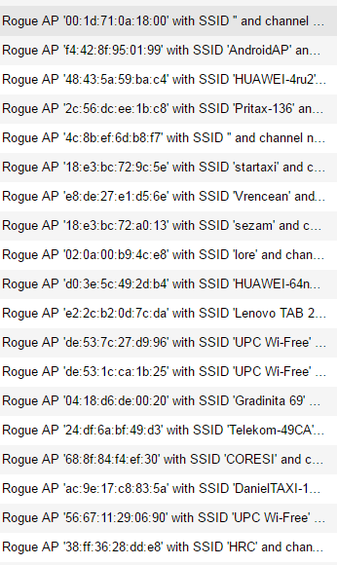
Localized Wi-Fi attacks and other Wi-Fi infrastructure security features
Wi-Fi infrastructure can detect the existence of Rogue APs
Rogue APs can be classified using rules like SSID, RSSI, Duration, Client Count, etc.
Extra APs can be put in monitor mode in order to scan full time the environment for these Rogue Aps
Containment of Rogue APs can be done especially when multiple APs are deployed in one hotspot but can have legal consequences
Using our Location services infrastructure Rogue APs, Rogue Clients, Interferers and wIPS Attackers can be detected and localized
Notes:
ePDG must have a strong re-authentication policy behavior ; not to delete GTP tunnel before reauthentication si completed

Slide 23
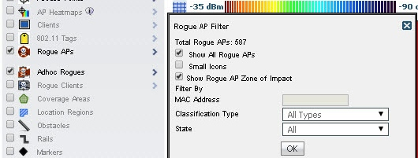
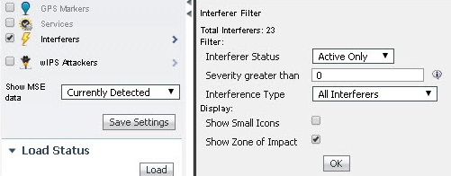
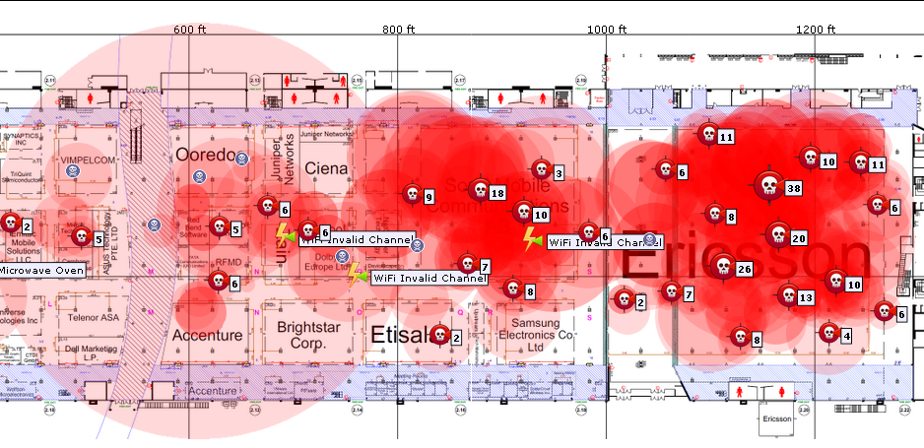
Localized Wi-Fi attacks location and zone of impact
Rogue Access Point
Non-WiFi Interferers
Notes:
ePDG must have a strong re-authentication policy behavior ; not to delete GTP tunnel before reauthentication si completed

Slide 24
Other security mechanism Management Frame Protection (MFP)
Problem
Wireless management frames are not authenticated, encrypted, or signed
A common vector for exploits
Solution
Insert a signature (Message Integrity Code/MIC) into the management frames
APs can instantly identify rogue/exploited management frames
Optionally, Clients and APs use MIC to validate authenticity of management frame
Beacons
Probes
Association
Beacons
Probes
Association
Notes:
ePDG must have a strong re-authentication policy behavior ; not to delete GTP tunnel before reauthentication si completed

Slide 25
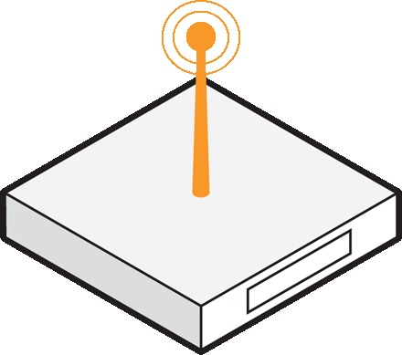
Wi-Fi network and services evolution
Orange central sites
managed Business Wi-Fi and Orange Wi-Fi [2012]
operator Wi-Fi
[2013]
Wi-Fi calling
[2015]
Retail Business Analytics
[2014]
Business Internet Security [2015]
v
v
v
mobile Wi-Fi core connected to 3G/4G core for a seamless wireless access experience
v
Wi-Fi tracking info converted into actionable business metrics
traffic filtering, application control, AV/AS, IPS/IDS, DDoS
Wireless Controllers
Hotspot Manager for personalized access and data collection
v
analytics engine and big data located into Orange IaaS
centralized security appliance and security operation center
captive portal
AAA
Wi-Fi GW
AAA
ePDG
client location
on premise security appliance
Orange
IP network
Wi-Fi AP
PE
Internet access
PE
aggregation switches
CPE
Wi-Fi AP

Slide 26
Continue your journey with Orange Defcamp Platinum Partner
Check out Business Internet Security Threat Map
App2Own – BUG BOUNTY
Nov 10th, from 9:00 – to Nov 10th, 19:00: on site contest, with most security features activated
Nov 11th, from 9:00 – to Nov 11th, 16:00: on site contest, with some security features deactivated
Wi-Fi PWNED Board

Slide 27
Thank you
Vlad Sorici
Development & Innovation Team

