Slide 1
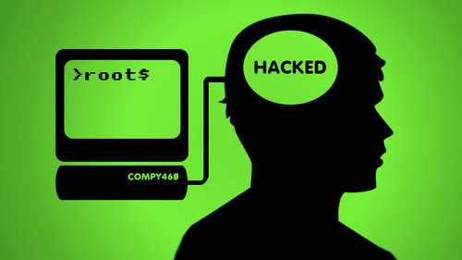
Split Personalities
The Phycology of Social Engineering
Dave Chronister
Managing Technical Partner
Parameter Security

Slide 2
About Me
Security Practitioner
Ethical Hacker
Forensic Investigator
(MO PI Lic#2012039253)
Instructor
PCI-QSA, PCI-ASV
Co-Founder Parameter Security
We Find, Not Fix Issues

Slide 3
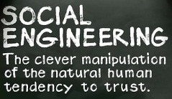

Slide 5
Logic
Emotion
Bill

Slide 6
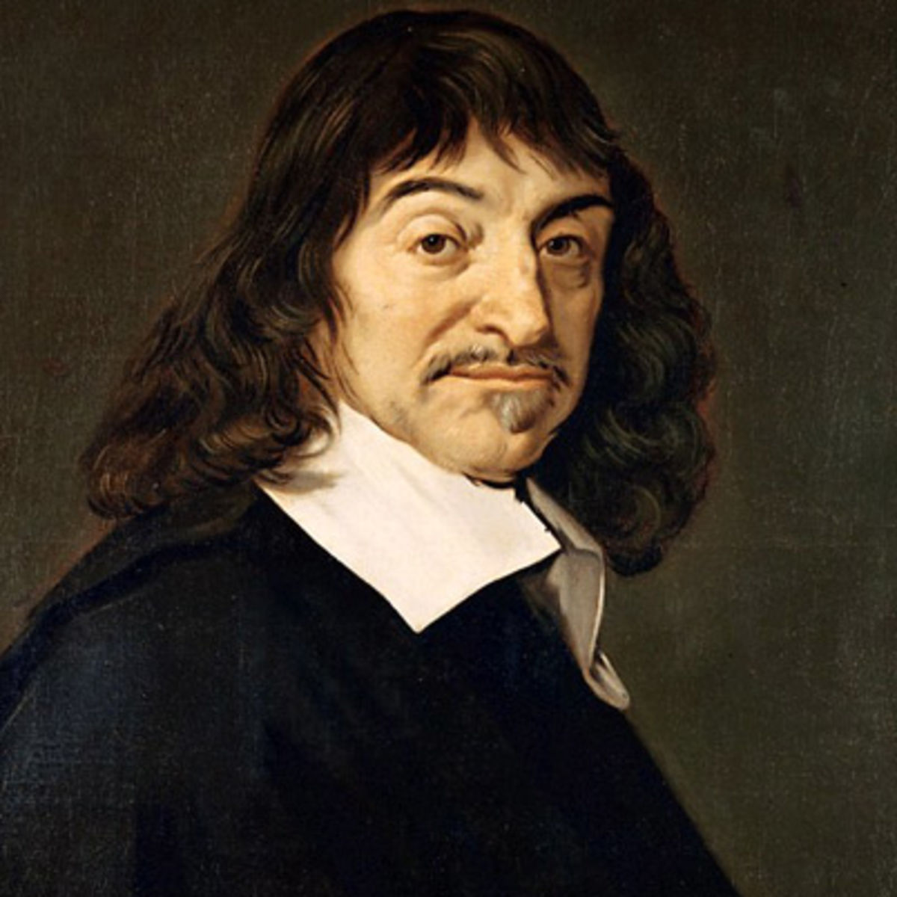
“Cogito ergo sum”
“I think therefore I am.”
-René Descartes

Slide 7
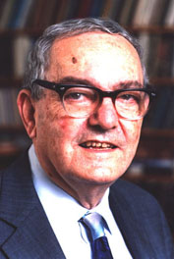
Hence, in order to have anything like a complete theory of human rationality, we have to understand what role emotion plays in it.
--A Reason in Human Affair
Herbert Simon

Slide 8
Emotional Triggers
Overwhelm
Reciprocation
Deceptive Relationships
Moral Duty
Authorities

Slide 9
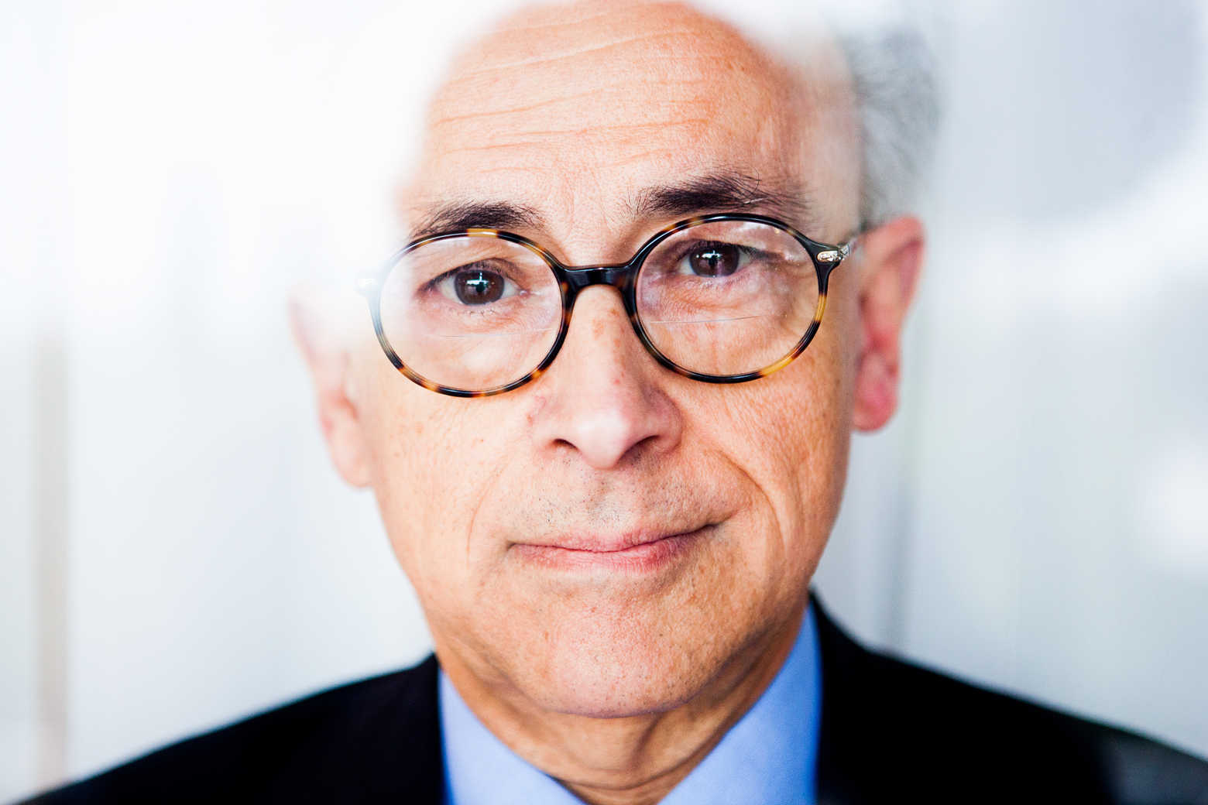
No matter how much a person analyzes, emotion will always determine the decision
Antonio Damasio

Slide 10
Phishing

Slide 11
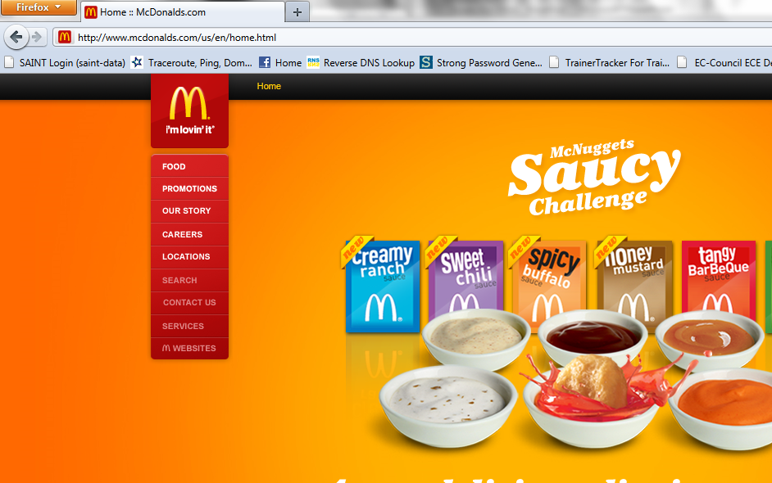
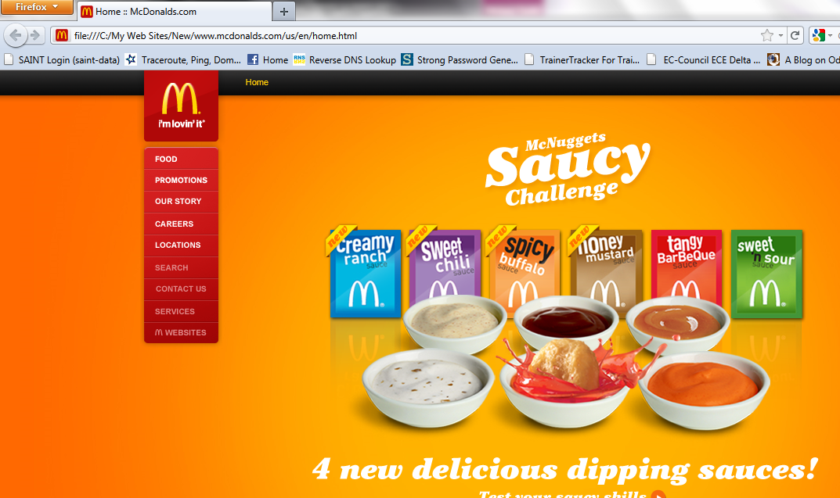
?Spot The Fraud?

Slide 12
Details in the URL
http://www.mcdonalds.com.menu.nutrition.mks.info
http://www.mcdonalds.com
http://www.mcdonalds.com.contest.entryls.com

Slide 13
Phishing Emails

Slide 15
Inspiration

Slide 16
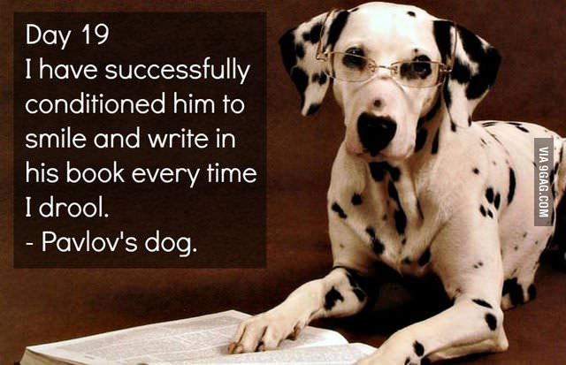
Conditioning Behavior

Slide 17
Condition Behavior through Security Awareness Programs
On-Going program
Defense must be second nature
Humans will eventually fail, because they’re human
Encourage to learn from the mistakes of others

Slide 18
Social Engineering does not happen because someone is stupid. Social Engineering exploits emotions.

Slide 19
Everyone is vulnerable to Social Engineering

Slide 20
Successful Social Engineering Attacks are very subtle.

Slide 21
Technology will not stop Social Engineering attacks. User security education is the best defense.

Slide 22
Questions?
Dave.Chronister@parametersecurity.com
@Bagomojo
www.ParameterSecurity.com

