Slide 1
Internet Balkanization in an era of military conflict
Dan Demeter
Senior Security Researcher, GReAT
@_xdanx

Slide 2
2008
The year Global Research and Analysis Team was founded

Slide 3
Kaspersky’s international expertise
GReAT

Slide 4
The Global Research and Analysis Team
Founded in 2008
An elite group of researchers: Approx. 40 experts in 20 different countries
Responsible for threat intelligence, research and innovation leadership
Focused on Advanced Persistent Threats, critical infrastructure threats, financial threats, and sophisticated targeted attacks

Slide 5
APT + sophisticated crime activity
We monitor more than 900 operations and groups
At least 20 are “commercial””
At least 25 groups are Chinese-speaking

Slide 6
Advanced persistent threat landscape
Kaspersky’s Global Research and Analysis Team (GReAT) is well-known for the discovery and dissemination of the most advanced cyberthreats.
Top targets for advanced persistent threats (APT) were governments, and the most significant threat actor was Lazarus.
Top 10 targets:
Government
Diplomatic
Telecommunications
Military
Defense
IT companies
Educational
Civil Aviation
Logistics
Pharmaceutical
Top 12 targeted countries:
Chile
Mexico
Brazil
France
UK
Turkey
India
Russia
China
Japan
South Korea
Hong Kong
Top 10 significant threat actors:
Lazarus
DarkHalo
CloudComputating
Turla
SideCopy
1
6
MuddyWater
APT41
BlueNoroff
HoneyMyte
Gamaredon
2
7
3
8
4
9
5
10
apt.securelist.com

Slide 7
What is Balkanization?

Slide 8
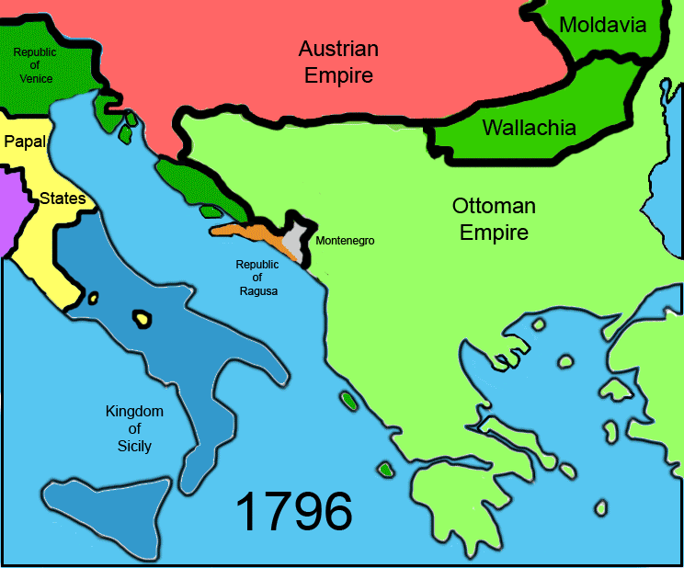
Source: Wikipedia - Balkanization

Slide 9
What is Splinternet?

Slide 10
Balkanization in the past decade:
China
India
Russia
North Korea
Iran
(smth we know)

Slide 11
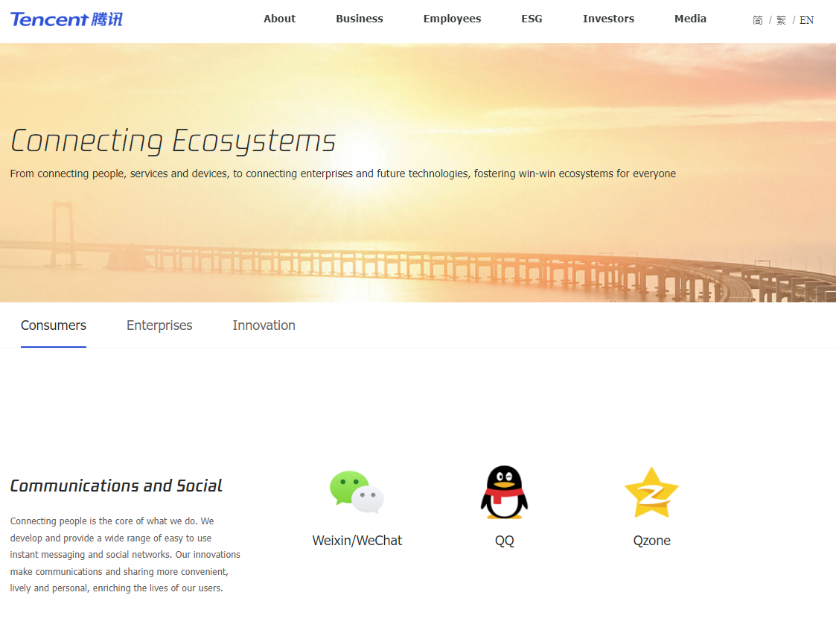

Slide 13
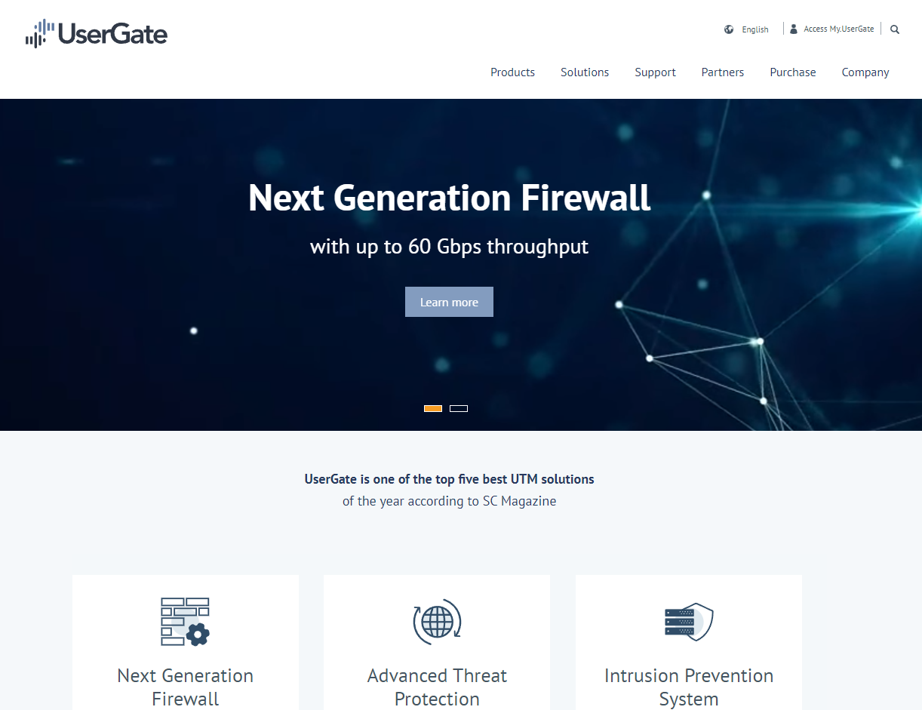

Slide 15
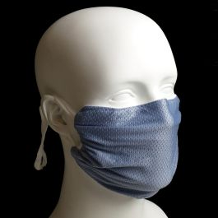
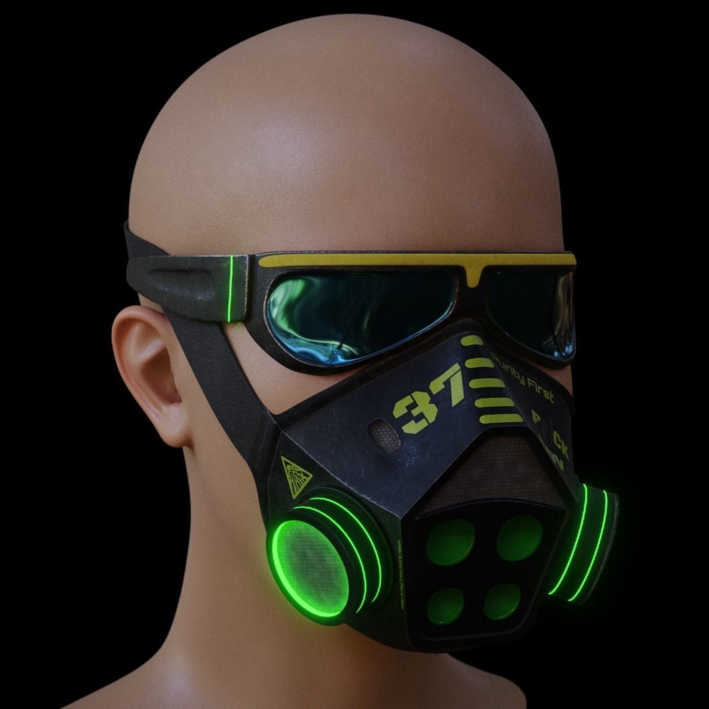
The big picture
2020-2021
The Covid-19 years
2022-2024(?)
The Cyberwar years
Notes:
Cyberwar is not what everyone expected

Slide 16
Threat Landscape during Armed Conflict in Ukraine

Slide 17
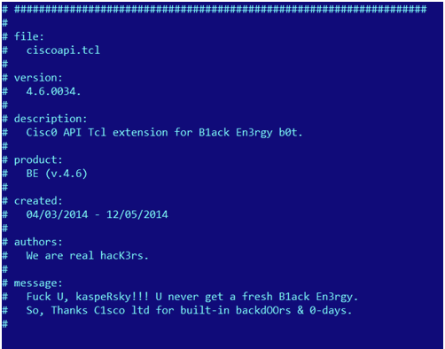
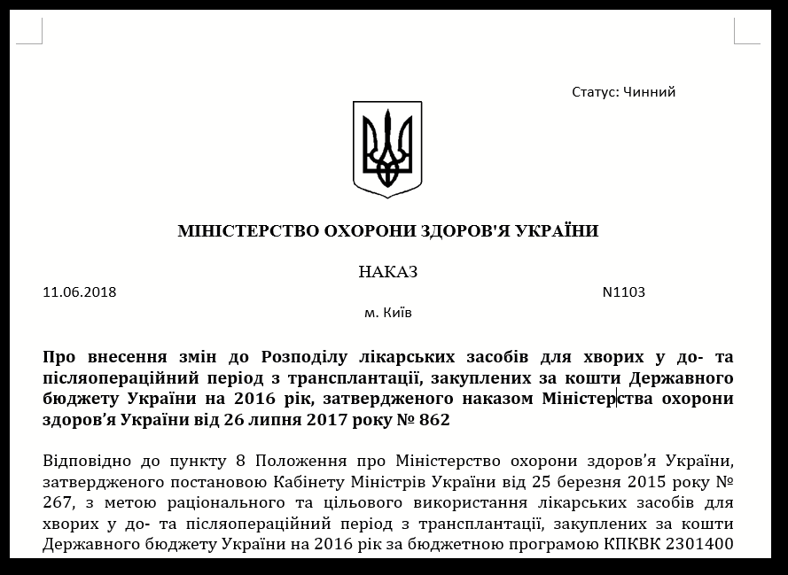
Cyberattacks in Ukraine
2014 BlackEnergy APT - routers hack, elections
Oct 2014 CyberBerkut leaks; Ukrainian Central Election Commission DDoS attacks
Dec 2015 Powergrid attack - BlackEnergy3, KillDisk
Dec 2016 Industroyer attack - ICS functionality
Jun 2017 NotPetya attack - supply chain
Oct 2017 BadRabbit attack - FlowerDandy framework
2018 - Hades cyberespionage
2019-2022 - spike in Gamaredon / Armageddon ops
Notes:
Costin

Slide 18
Overview of APT attacks in Ukraine
APT name | First active | Currently active in UA
RedOctober | 2007 | No
Dukes .. APT29 | 2013 | Unknown
Turla | 2008 | No
Sofacy / APT28 | 2008 | Yes
CrouchingYeti / E.B. | 2010 | No
BlackEnergy APT (BE2,3) | 2013-2014 | No
Hades / Sandworm / Telebots | 2015 | Unknown
Gamaredon | 2013 | Yes, highly active
UNC1151 / Ghostwriter | 2016 | Yes
Notes:
Costin

Slide 19
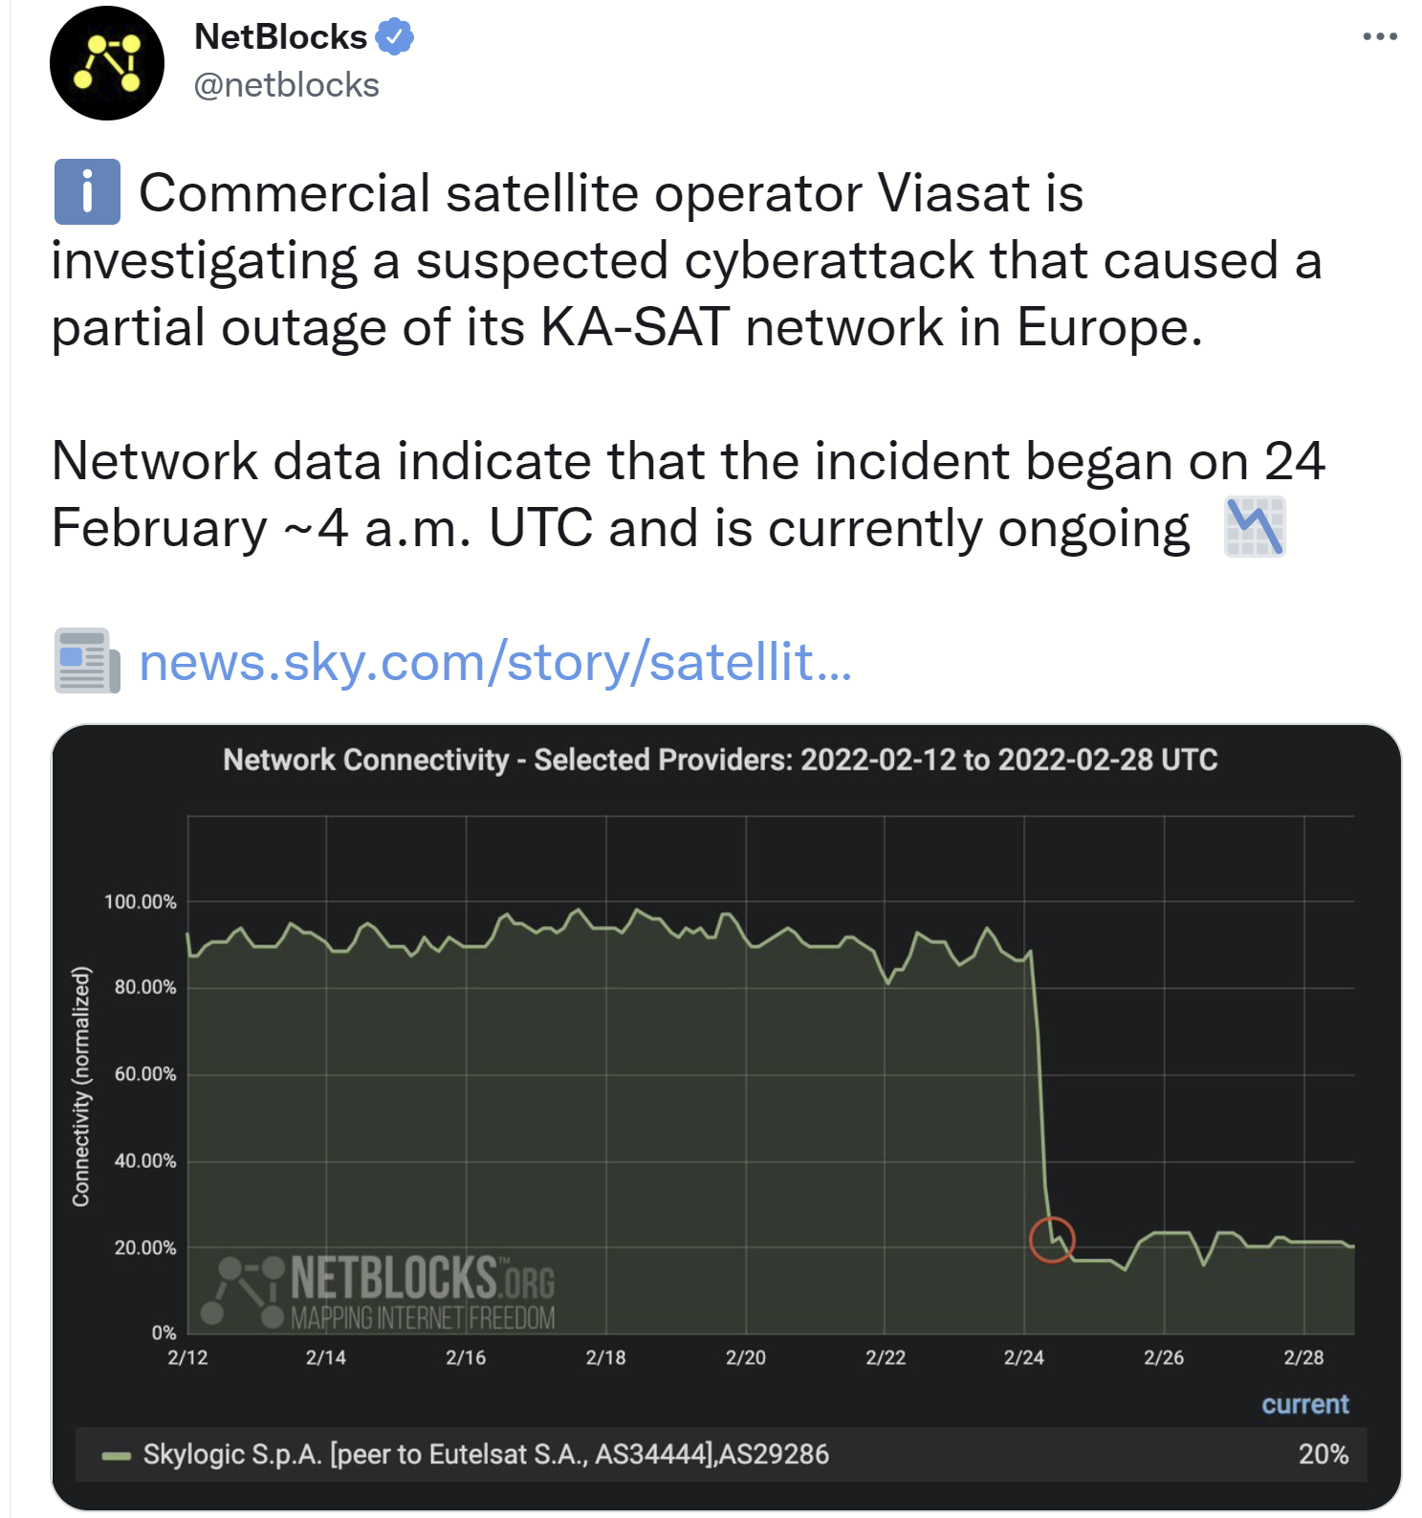
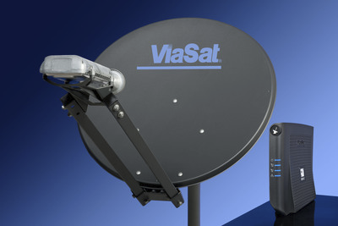
On Feb 24th, around 4am UTC, thousands of Viasat satellite modems (eg. Surfbeam 2) stopped working
Modems are “bricked”, lights won’t turn on
Collateral damage
Result of “cyber event”. LEA investigating.
Notes:
Costin

Slide 20
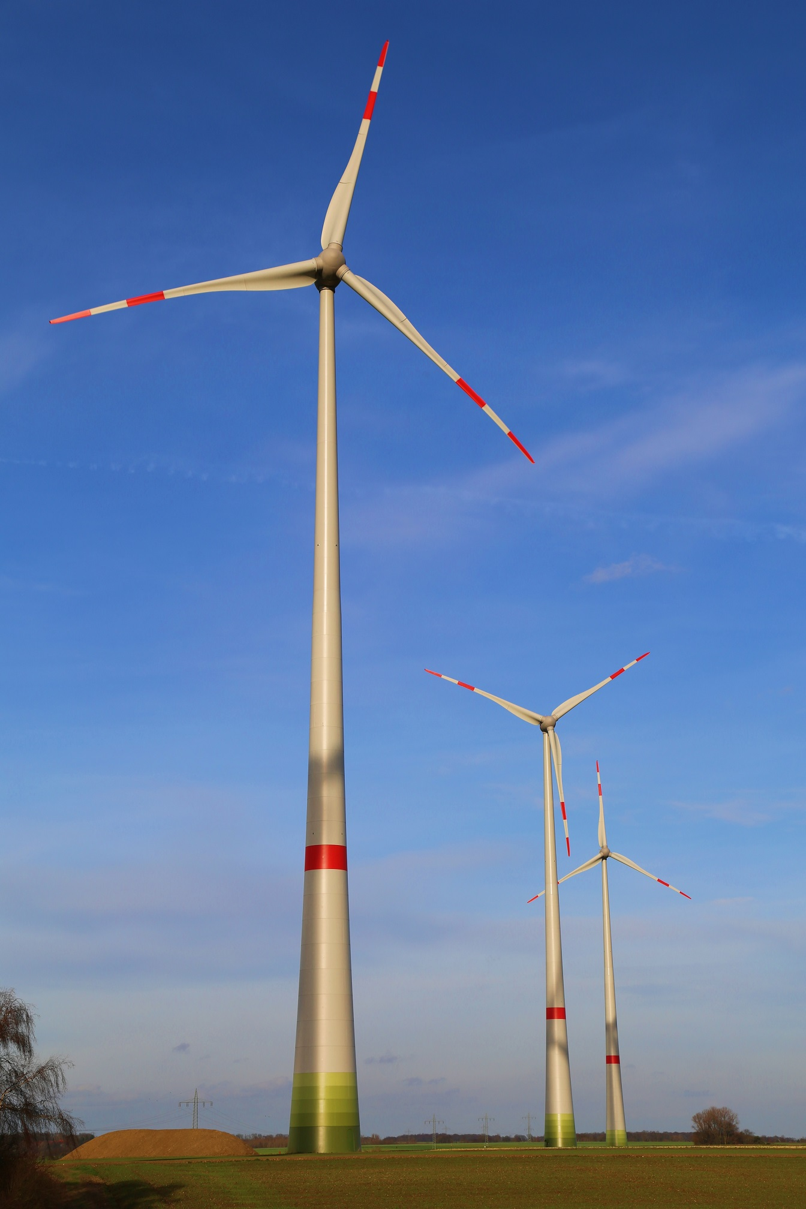
The Viasat “cyber event”
“Viasat is experiencing a partial network outage — impacting internet service for fixed broadband customers in Ukraine and elsewhere on our European KA-SAT network,”
Viasat provides KA-SAT service
5,800 of Enercon’s turbines, with 11GW of total capacity, have been affected
Overall 30,000+ terminals in Europe were believed to have been affected
Hackers (likely Hades APT group) delivered a malicious update OTA to all Viasat modems
Remote hack of the SAT management network

Slide 21
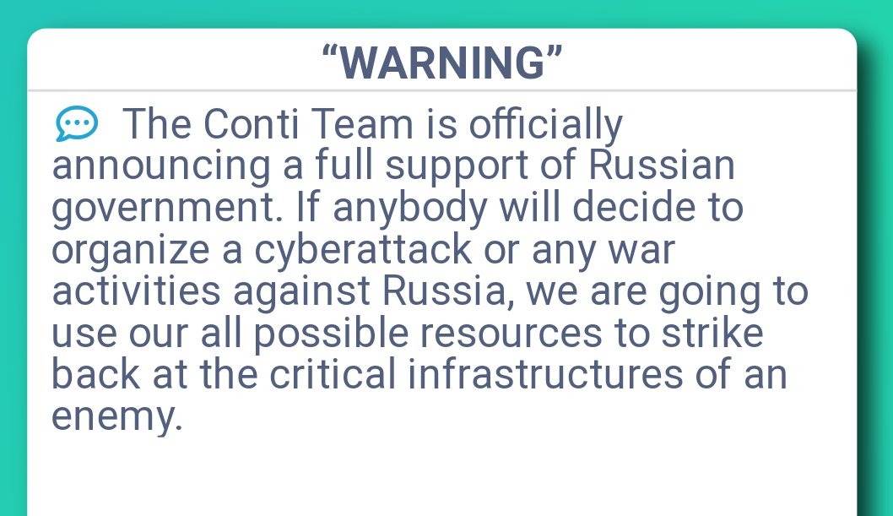
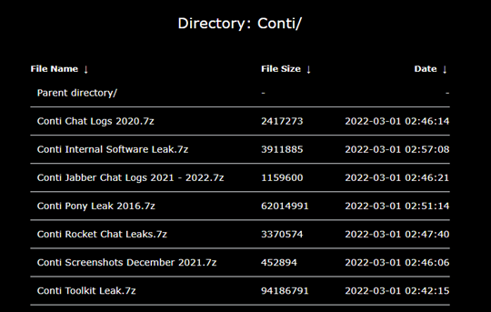
Hacktivists Attacks and Conti Ransomware
?
Source: Kaspersky Threat Intelligence
Notes:
As the geopolitical situation between Russia and Ukraine intensifies, including kinetic military action, cyber-offensive risks increase significantly between both countries. While in such a situation the source of the cyberattacks is likely to be associated with state-sponsored threat actors, we have noted a new type of engagement in this conflict; cybercrime forums and ransomware groups reacting to the situation and taking action. We have recently published two reports on HermeticWiper19 and HermeticRansom20 detected in Ukraine, affecting multiple industries such as government institutions, NGOs, and IT companies.
The most significant reaction of all is likely the Conti ransomware group. On February 25, Conti published a message on their news site with a statement that they will retaliate with full capabilities toward any “enemy’s” critical infrastructure if Russia becomes a target of cyberattacks. That is probably a rare example in which a cybercriminal group supports a nation-state publicly. On the other hand other communities such as Anonymous, IT ARMY of Ukraine and Belarusian Cyber-Partisans openly support Ukraine.

Slide 22
Overview of current
cyber activity in Ukraine
Known APT
activity
Hacktivism
Info-
war
Unknown parties
(DDoS, commodity)
Cybercriminals
Unattributed APTs

Slide 23
2023 predictions
Cyberwarfare will continue to play an important role
Expect disruptions, collateral damage, destructive attacks, DDoS
More supply chain attacks including open source repositories
Work from home redefines the attack surface
“Pentester++” level ransomware attacks, hacking collectives
Sophisticated attacks, low level infiltration
Living off the land
Cloud attacks, 2FA bypass, 2FA fatigue

Slide 25
DDoS Attacks

Slide 26
The curious case of a bookstore shop

Slide 27
Blocking Firewall firmware upgrades
10th Oct - CVE-2022-40684

Slide 28
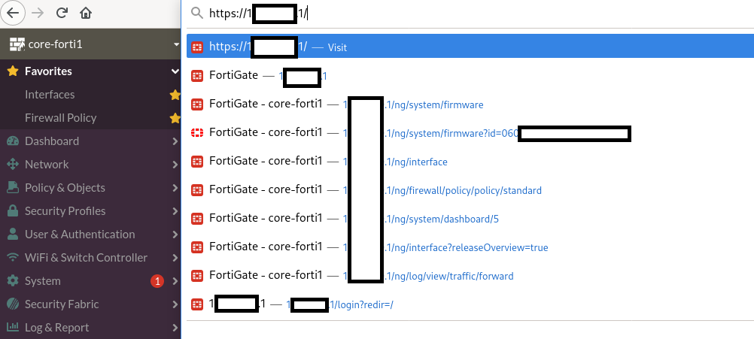
Blocking Firewall firmware upgrades

Slide 29
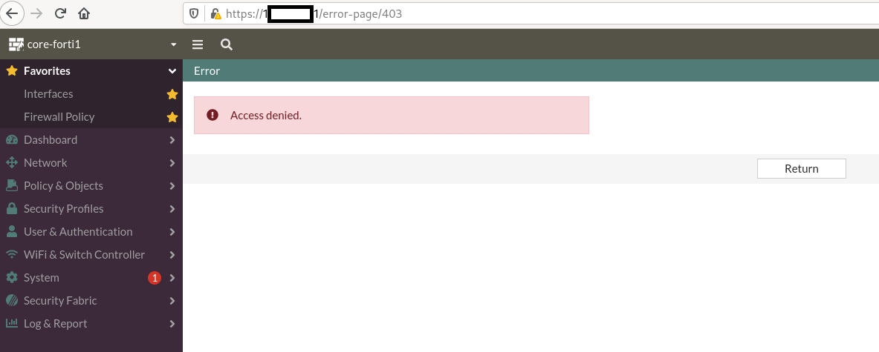
Blocking Firewall firmware upgrades

Slide 30
Balkanization nowadays
(some examples)
All from before
US
Europe
(smth new)

Slide 31
?

Slide 32
Communication

Slide 33
Communication

Slide 34
Solutions
Communities working together
Industry cooperation
Partnership with private companies

Slide 35
Break

Slide 36
the

Slide 37
isolation

Slide 38
barriers

Slide 39
Solutions
Communities working together
Industry cooperation
Partnership with private companies
Break the isolation barriers

Slide 40
Those in power don’t have (enough) competence
Those with competence don’t have (enough) power

Slide 41
Long term risks:
Slowly accepting
more & more restrictions

Slide 42
https://apti.ro
https://t.me/aptiromania

Slide 43
Let’s start the debate!
@_xdanx

