Slide 1
DNS protocol in hands of attacker
Prepared by:
Jan Ryneš
Solutions Architect
jrynes@Infoblox.com +420731591259

Slide 2


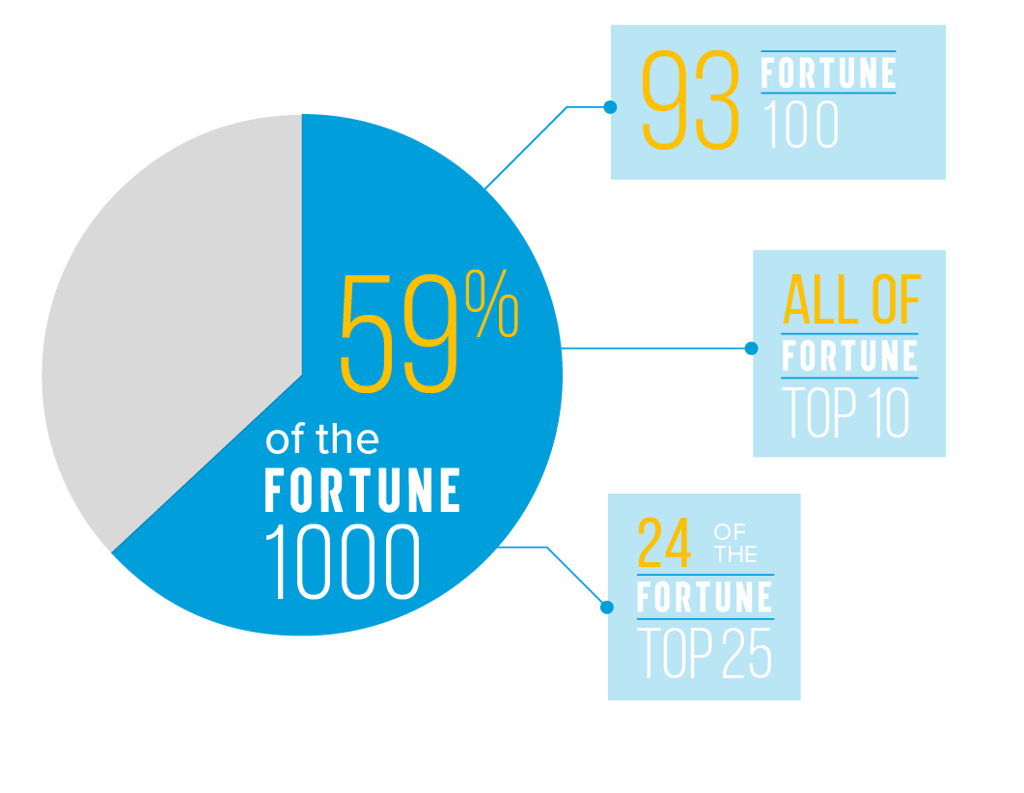



Secure DNS Leading Vendor
US Company
12,000+ customers
„Infoblox accounting for approximately 50% of the existing installed base”

Slide 3
How DNS is used by malware?
DNS Protocol Anomalies
DNS Exploits
DNS Hijacking
DNS Resolution
DNS Callback
DNS Tunneling
Weaponization
Exploitation
Command & Control (C2)
Coupling exploit with backdoor into deliverable payload
Exploiting a vulnerability to execute code on victim’s system
Command channel for remote manipulation of victim
2
4
6
1
3
5
7
Reconnaissance
Delivery
Installation
Actions on Objectives
Harvesting email addresses, conference information, etc.
Delivering weaponized bundle to the victim via email, web, USB, etc.
Installing malware on the asset
With “Hands on Keyboard” access, intruders accomplish their original goal
DNS Resolution
DNS Infiltration
DNS Tunneling
DNS Exfiltration
DNS DDoS
DNS Reconnaissance

Slide 4
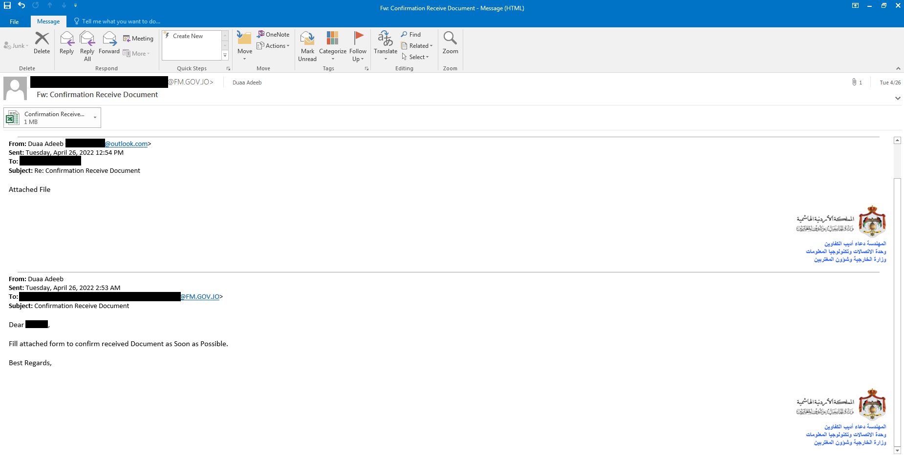
APT34: targeting governments
Iranian APT34 (aka HELIX KITTEN or OilRig) targeting Jordanian government
Email to gov official, pretending to be sent by IT employee
Source: https://blog.malwarebytes.com/threat-intelligence/2022/05/apt34-targets-jordan-government-using-new-saitama-backdoor/
https://www.fortinet.com/blog/threat-research/please-confirm-you-received-our-apt

Slide 5
APT34: monitoring execution with DNS
Malicious XLS attachment relying on user to enable VBA macro
Anti sandbox: is there a mouse connected?
Each macro execution step is reported via DNS queries to C2 domain:
“qw” + id of the step + random number + C2 domain name
ie.: qwzbabz7055.joexpediagroup[.]com
DNS queries sent by calling Win32_PingStatus WMI function
XLS contains Base64 encoded backdoor, which is stored in Excel user forms
Persistence: scheduled task run every 4 hours, for 20 days
Source: https://blog.malwarebytes.com/threat-intelligence/2022/05/apt34-targets-jordan-government-using-new-saitama-backdoor/
https://www.fortinet.com/blog/threat-research/please-confirm-you-received-our-apt

Slide 6
APT34: Saitama backdoor with C2 over DNS
.NET binary
It can execute pre-coded PowerShell and CMD commands, custom commands or download files from C2
uses C2 over DNS
  nbn4vxanrj.joexpediagroup[.]com 75.99.87.203
  aonrc.uber-asia[.]com 129.0.0.4
  k7myyynr6.asiaworldremit[.]com 70.118.101.114
  p6yqqqqp0b67gcj5c2r3gn3l9epztnrb.asiaworldremit[.]com
Long random delays (40-80 seconds)
Failed DNS query will cause malware to sleep for 6-8 hours (!)
DNS queries: [Content][Counter].[c2domain]
Optional data compression
Changes C2 domains from a list of 3 hardcoded domains (registered on Jan 20th and Feb 27th, which is 2-3 months before the attack)
Counter encoded with Base36 and custom alphabet: “razupgnv2w01eos4t38h7yqidxmkljc6b9f5”
Content encoded by simple substitution using alphabet generated with the counter
C2 responds to initial query with an IP address with last octet being a unique ID of infected host
Results of executed commands are compressed, Base32 encoded and sent as DNS queries
Source: https://blog.malwarebytes.com/threat-intelligence/2022/05/apt34-targets-jordan-government-using-new-saitama-backdoor/
https://www.fortinet.com/blog/threat-research/please-confirm-you-received-our-apt

Slide 7
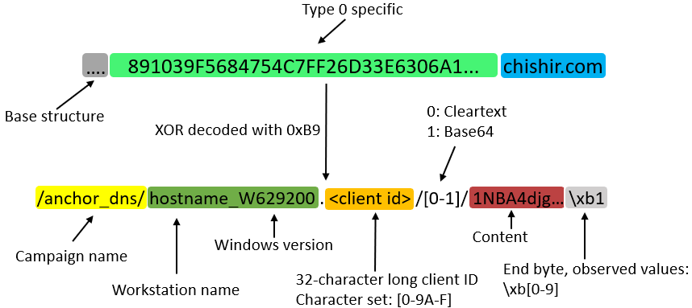
Example: TrickBot variant “Anchor_DNS”
Trickbot variant deployed on targets in the financial sector and high impact servers such as AD controllers
Deployment on-request by premium customers of the TrickBot group
The actor investigates the newly infected victims and if the victim is of high importance the TrickBot operator migrates this victim to the Anchor_DNS campaign
Why C2 over DNS:
  DNS monitoring is lacking in certain organizations
  Important systems such as AD controllers are often expected to perform DNS requests but not HTTP(S) traffic to unknown destinations.
Source: https://hello.global.ntt/insights/blog/trickbot-variant-communicating-over-dns

Slide 8
Linux version of „Anchor_DNS”
„Also has a Windows version of the malware embedded inside that it can install on remote windows shares and then execute as a service.
[..]
The further development of the Anchor family of malware suggests the trickbot family intends to continue utilizing its new DNS based command and control comms.
Given the generally lower rate of linux malware detection it is of the utmost importance organization closely monitor their network traffic and DNS resolutions”
Source: https://medium.com/stage-2-security/anchor-dns-malware-family-goes-cross-platform-d807ba13ca30
https://hello.global.ntt/insights/blog/trickbot-variant-communicating-over-dns

Slide 9
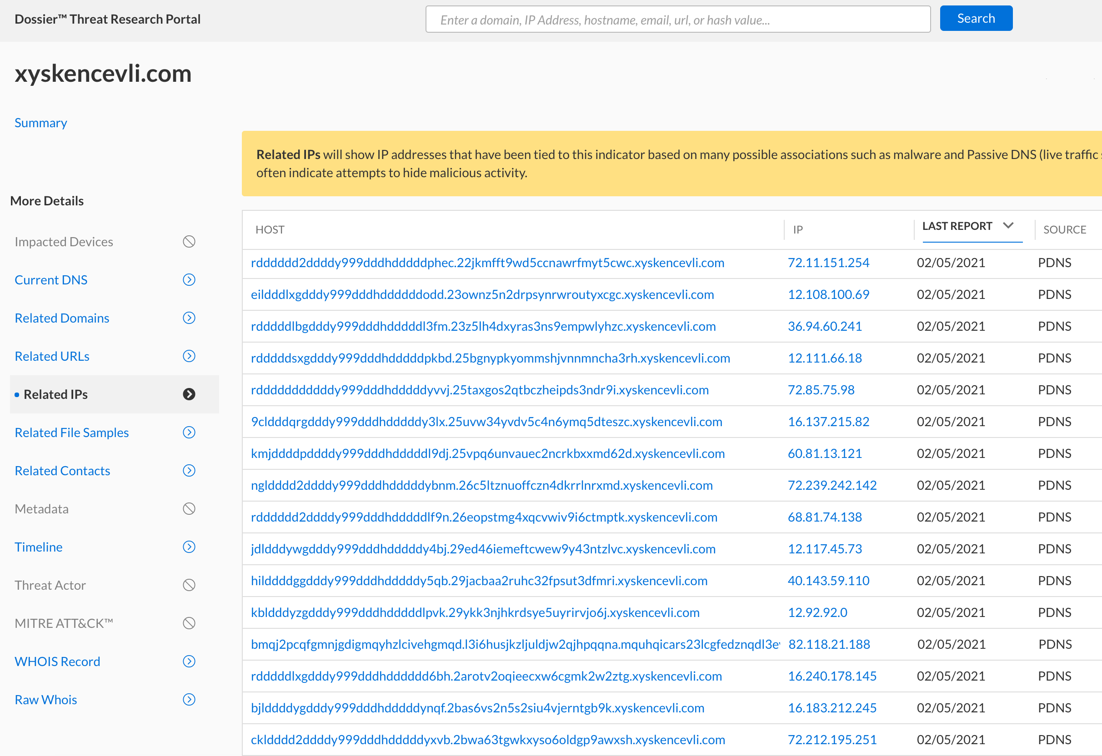
Ryuk and Anchor DNS
started with a DocuSign themed Excel maldoc
an hour after initial execution of Bazar loader, a Cobalt Strike beacon was loaded, followed by Anchor DNS
C2 domains hardcoded
Source: https://thedfirreport.com/2021/03/08/bazar-drops-the-anchor/

Slide 10
Detecting DNS Tunnels & Data Exfiltration
Infoblox approach
Signature
Reputation
Behavior
Threat Intelligence

Slide 11
Infoblox Threat Insight
Detecting communication over DNS using behavioral analysis
Entropy
Lexical
N-Gram
Frequency
Behavioral Analysis
Size
  Introduced in January 2016
  Detects transmission of data in DNS queries using behavioral analysis
  Uses patented algorithm (US 2016/0294773 A1)
  Examines all DNS records (e.g.: TXT, A, AAAA)
  Certain attributes add to a threat score;
  others subtract from it
  Final score classifies a request as exfiltration or not

Slide 12
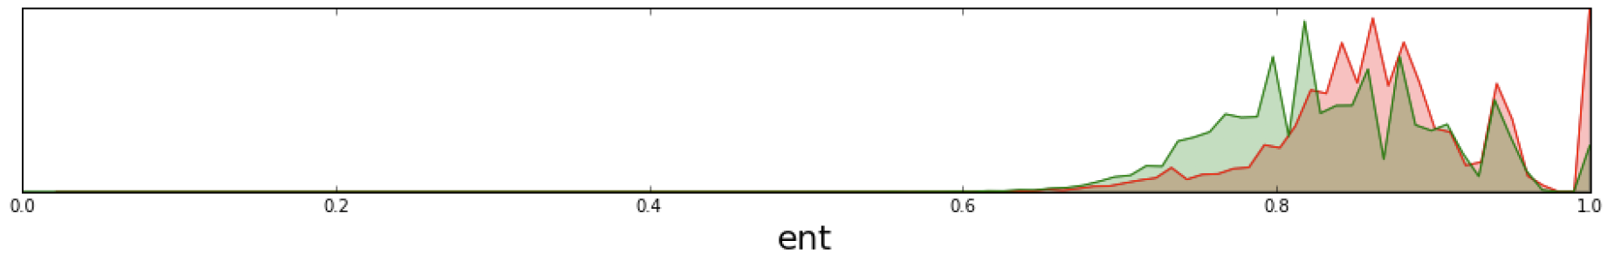
Infoblox ThreatInsight
Entropy
  Higher Entropy => more information transferred
  Legitimate DNS names often have dictionary words or something that looks meaningful.
  Encoded names have a higher entropy. DNS names that have high entropy can be an indicator of tunneling

Slide 13

Entropy Score
String | Shannon Entropy
www | 0
.com | 2
www.vw.com | 2.32
www.Infoblox.com | 3.28
www.google.com | 2.84
ljivlsk5++dfg654gdf6 | 3.62
135840A4B15F | 3.08
W.3217376901.IO.aHR0CHM6Ly91CGRhdGUu29vZ2xIYXBpcy5jb20V | 4.67
https://planetcalc.com/2476/

Slide 14
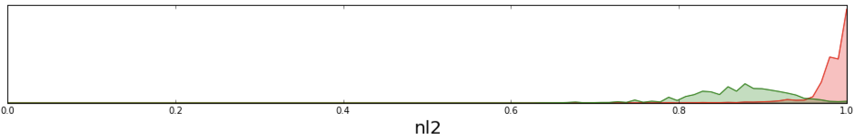
Infoblox ThreatInsight
N-Gram
  Detects non human like domain names based on character distribution.
  Focus is on 2- and 3-gram (i.e. sequences of 2 or 3 characters, or bigram and trigram analysis).

Slide 15
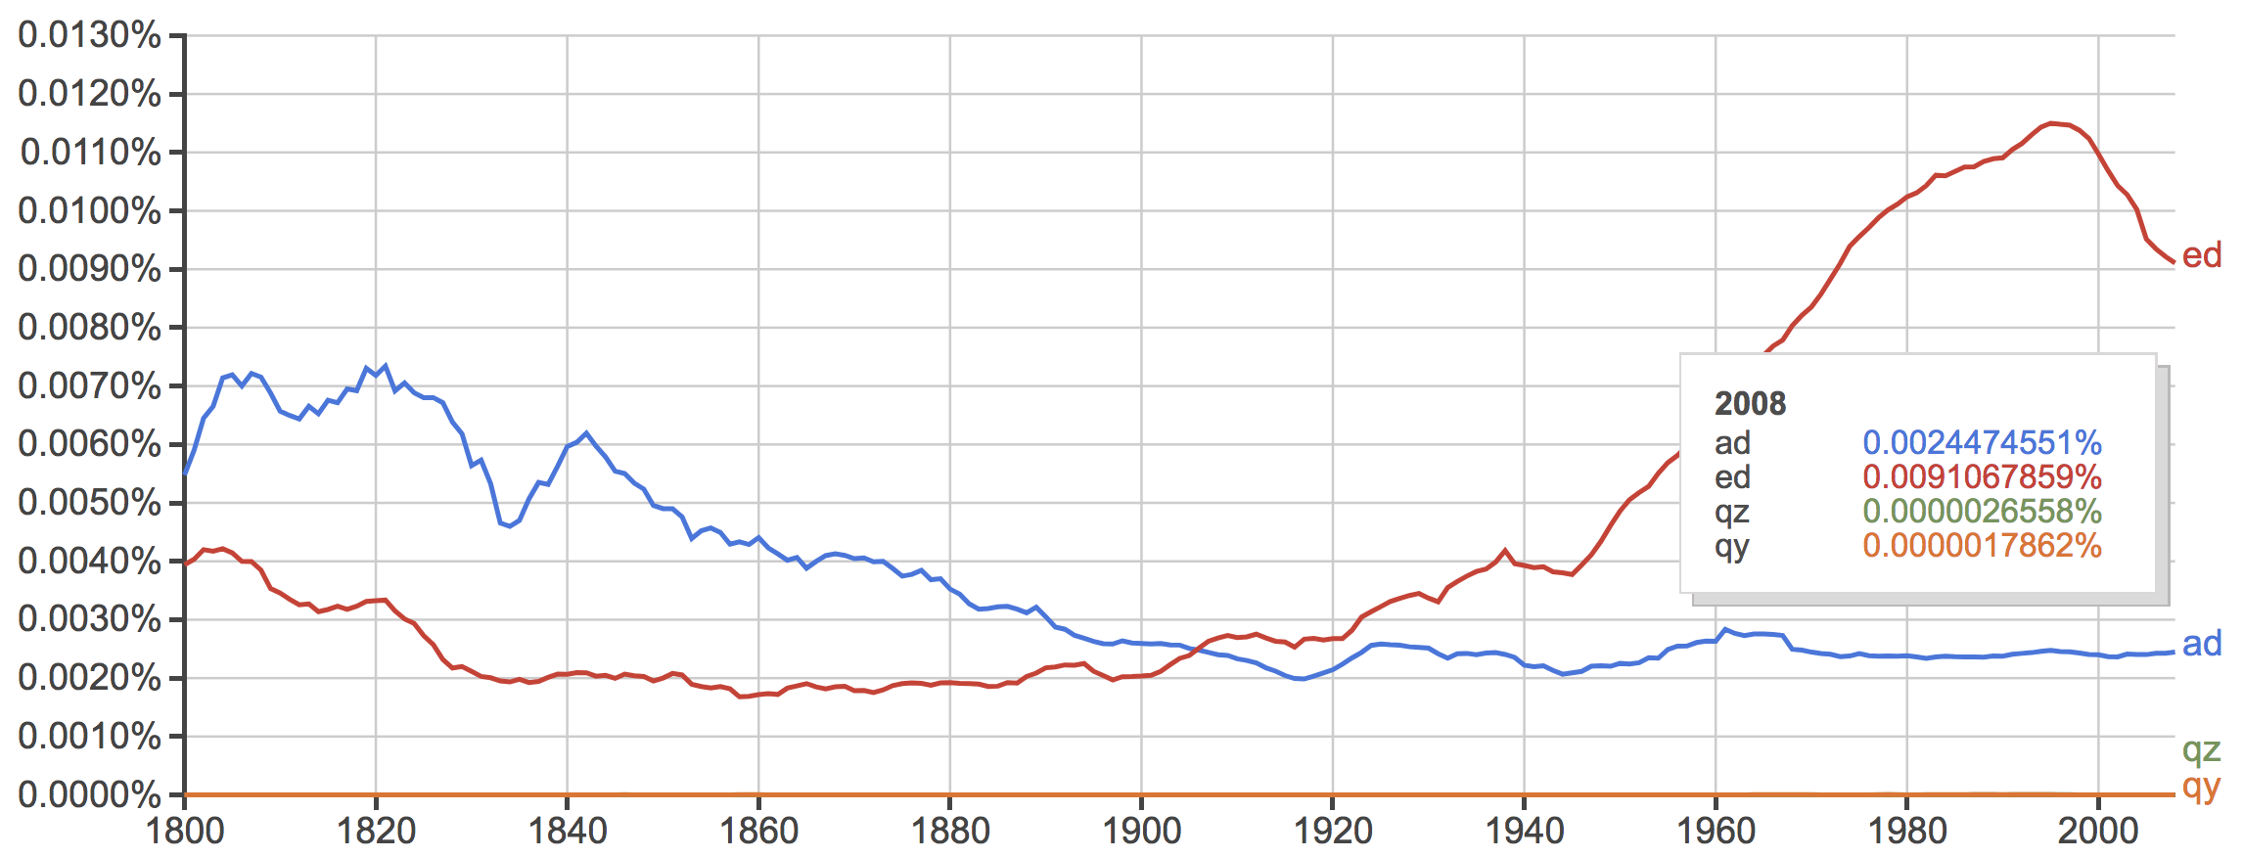
Google Books Ngram Viewer
Source: https://books.google.com/ngrams

Slide 16


DGA – Domain Generation Algorithm
An algorithm producing Command & Control (C2) rendezvous points dynamically
For example: every day malware connects to time-based server FQDN: <month>-<day>-<year>.com
ie. on December 24, 2017 malware connects to 2017-12-24.com
DNS query: ajdhkbf.info
DNS Reply: NXdomain
DNS query: dnskasd.info
Bot
DNS Reply: NXdomain
DNS server
DNS query: akdjnfag.info
DNS Reply: 135.175.17.35
Example Family | Example Domain
DirCrypt | vlbqryjd.com
Bamital | b83ed4877eec1997fcc39b7ae590007a.info
CCleaner | ab6d54340c1a.com
Contact 135.175.17.35
Malicious Payload
Bot
C2 Server
IP 135.175.17.35

Slide 17
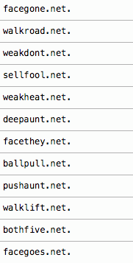
Dictionary DGA
Dictionary 1:
face
walk
weak
sell
deep
ball
push
both
Dictionary 2:
gone
road
dont
fool
heat
aunt
they
lift
goes
Suppobox malware domains:
+
Dictionary DGA | Example Family | Example Domain
Wordlist | Suppobox | facegone.net
Permutation | VolatileCedar | dotnetexplorer.info

Slide 18
Dictionary DGA Detection
Suppobox malware domains:
walkroad.net
walk + road
roadlift.net
road + lift
road
walk
lift
Words are used repeatedly!
DGA words connect differently!

Slide 19
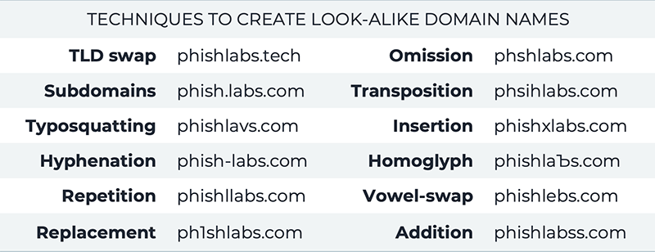
Lookalike domain techniques

Slide 20
Lookalike Domain Detection
pаypаl.com
pąypąl.com
paypal.com
Text
Punycode
xn--pypl-53dc.com
xn--pypl-btac.com
paypal.com
google.com
gοοgle.com
gооgle.com
Text
Punycode
google.com
xn--ggle-0nda.com
xn--ggle-55da.com
Notes:
/www.punycoder.com/https:/
pаypаl.com
pąypąl.com
paypal.com
google.com
gοοgle.com
gооgle.com

Slide 21
Key takeaways
DNS is open distributed database
  Can contain ANY information
DNS is communication protocol transmitting information
from point A to point B
Resolvers are acting like a Proxy

